Slide 1
Chapter 20 Generic Classes and Methods

Slide 2
Objectives
In this chapter you’ll:
Create generic methods that perform identical tasks on arguments of different types.
Create a generic Stack class that can be used to store objects of any class or interface type.
Learn about compile-time translation of generic methods and classes.
Learn how to overload generic methods with non-generic or generic methods.
Use wildcards when precise type information about a parameter is not required in the method body.

Slide 3
20.1 Introduction
Generic methods and generic classes (and interfaces) enable you to specify, with a single method declaration, a set of related methods, or with a single class declaration, a set of related types, respectively.
Generics also provide compile-time type safety that allows you to catch invalid types at compile time.

Slide 4
20.2 Motivation for Generic Methods
Overloaded methods are often used to perform similar operations on different types of data.
Study each printArray method.
Note that the type array element type appears in each method’s header and for-statement header.
If we were to replace the element types in each method with a generic name—T by convention—then all three methods would look like the one in Fig. 20.2.

Slide 5
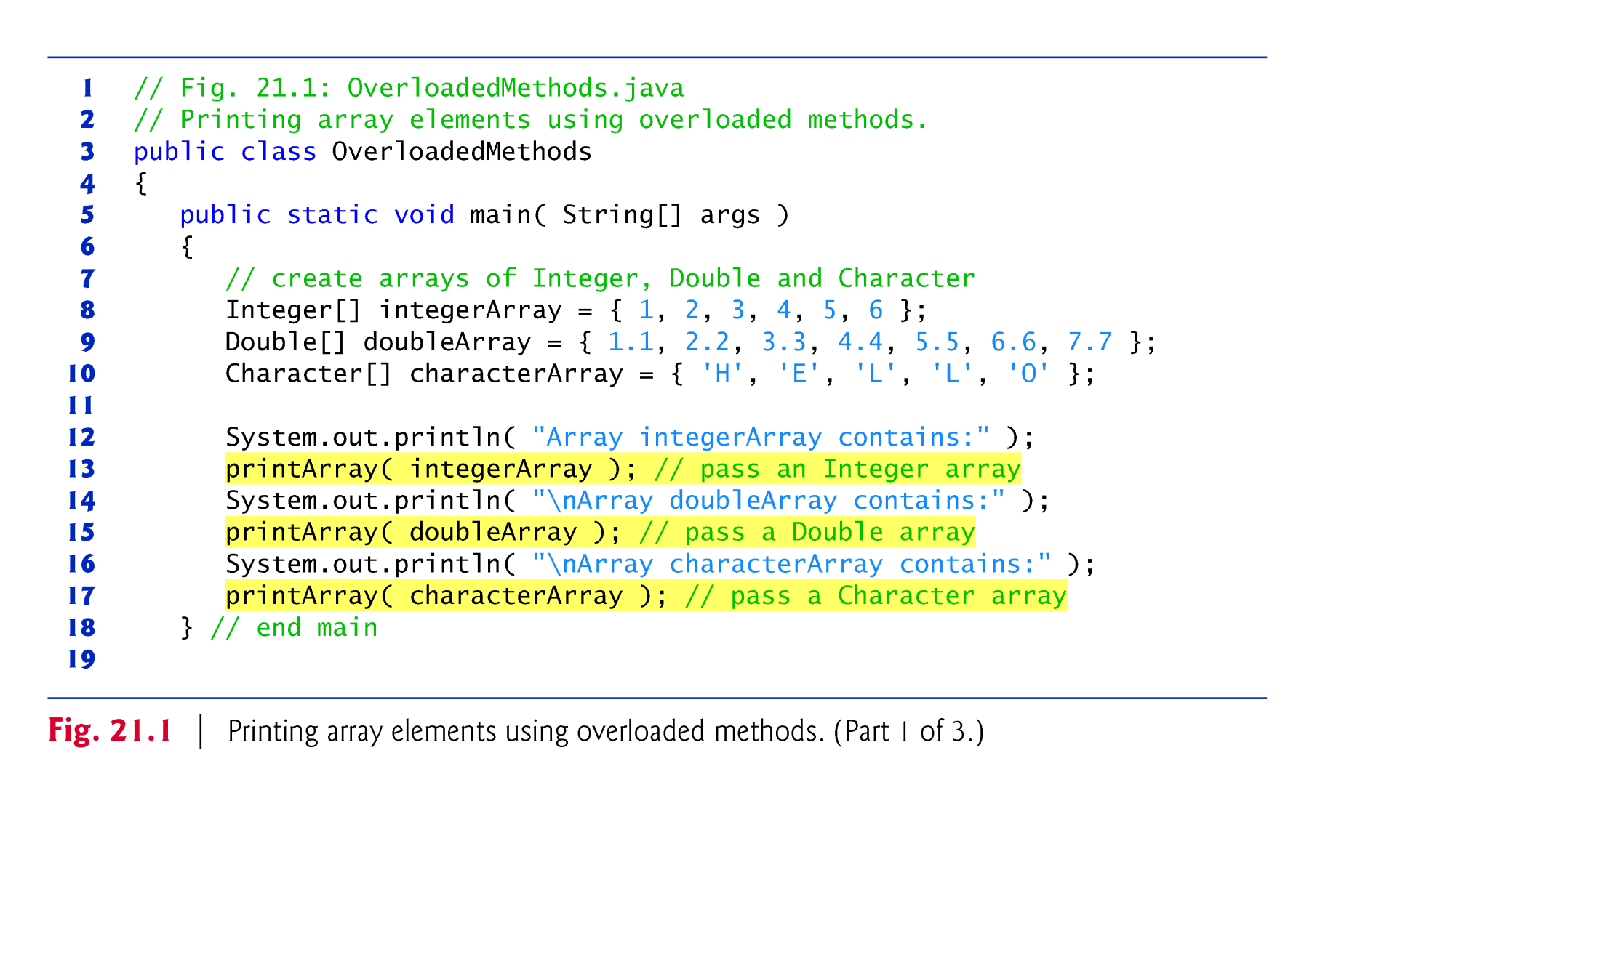

Slide 6
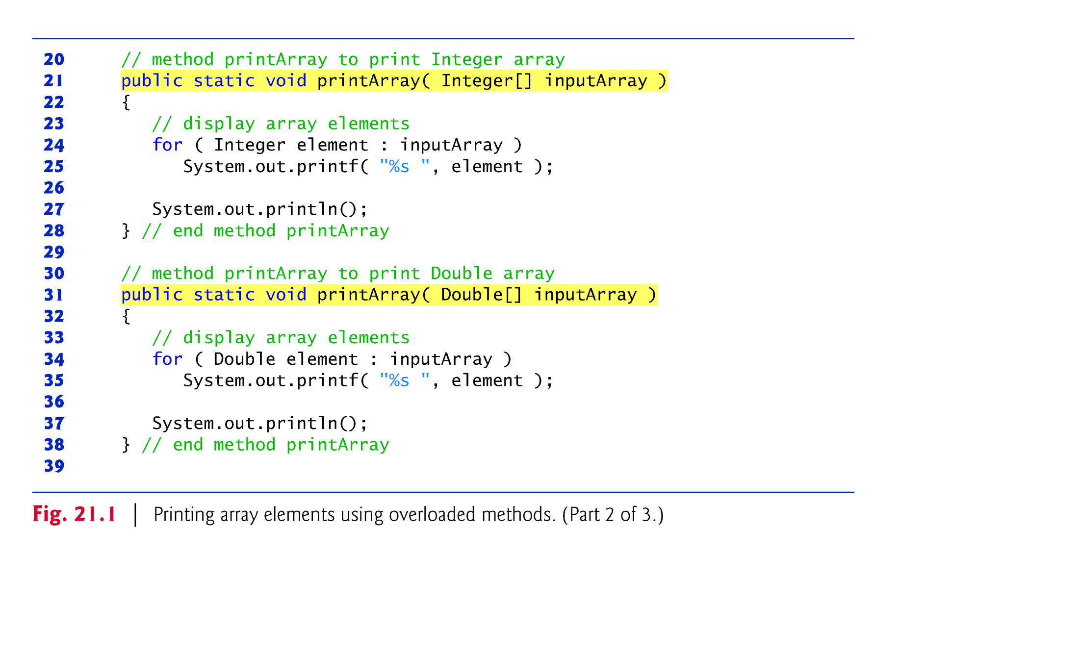

Slide 7
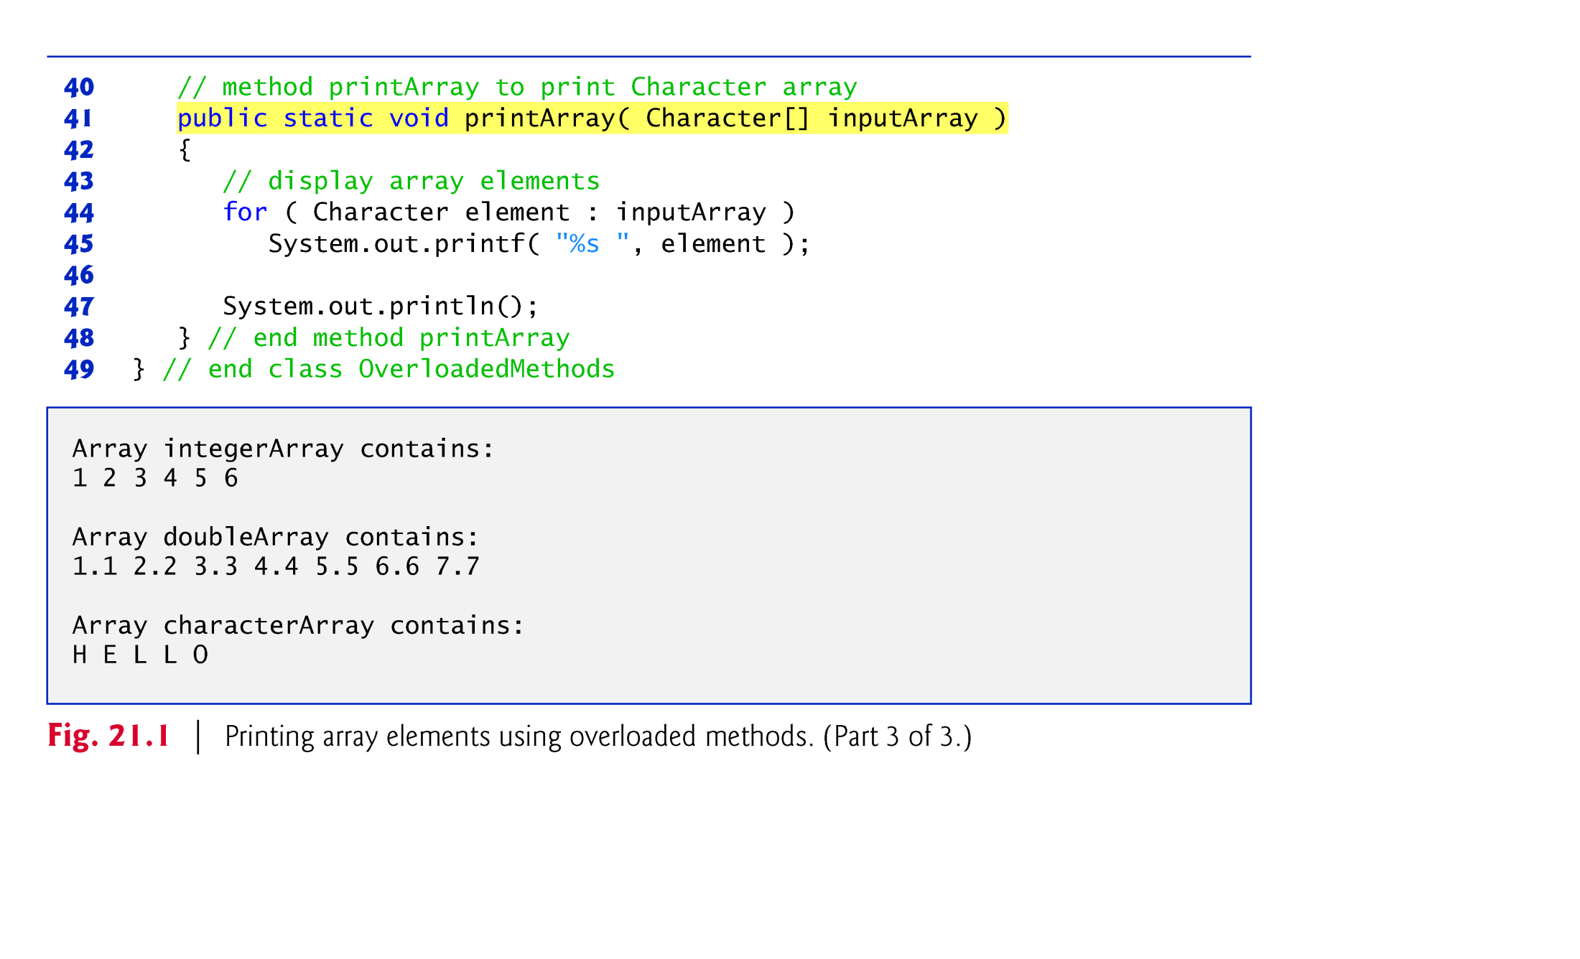

Slide 8
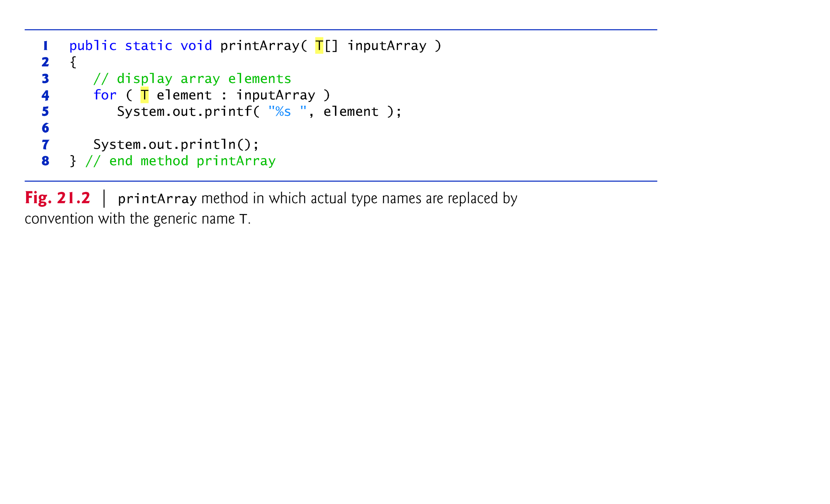

Slide 9
20.3 Generic Methods: Implementation and Compile-Time Translation
If the operations performed by several overloaded methods are identical for each argument type, the overloaded methods can be more compactly（简洁地） and conveniently coded using a generic method.
Based on the types of the arguments passed to the generic method, the compiler handles each method call appropriately.
Line 22 begins method printArray’s declaration.

Slide 10
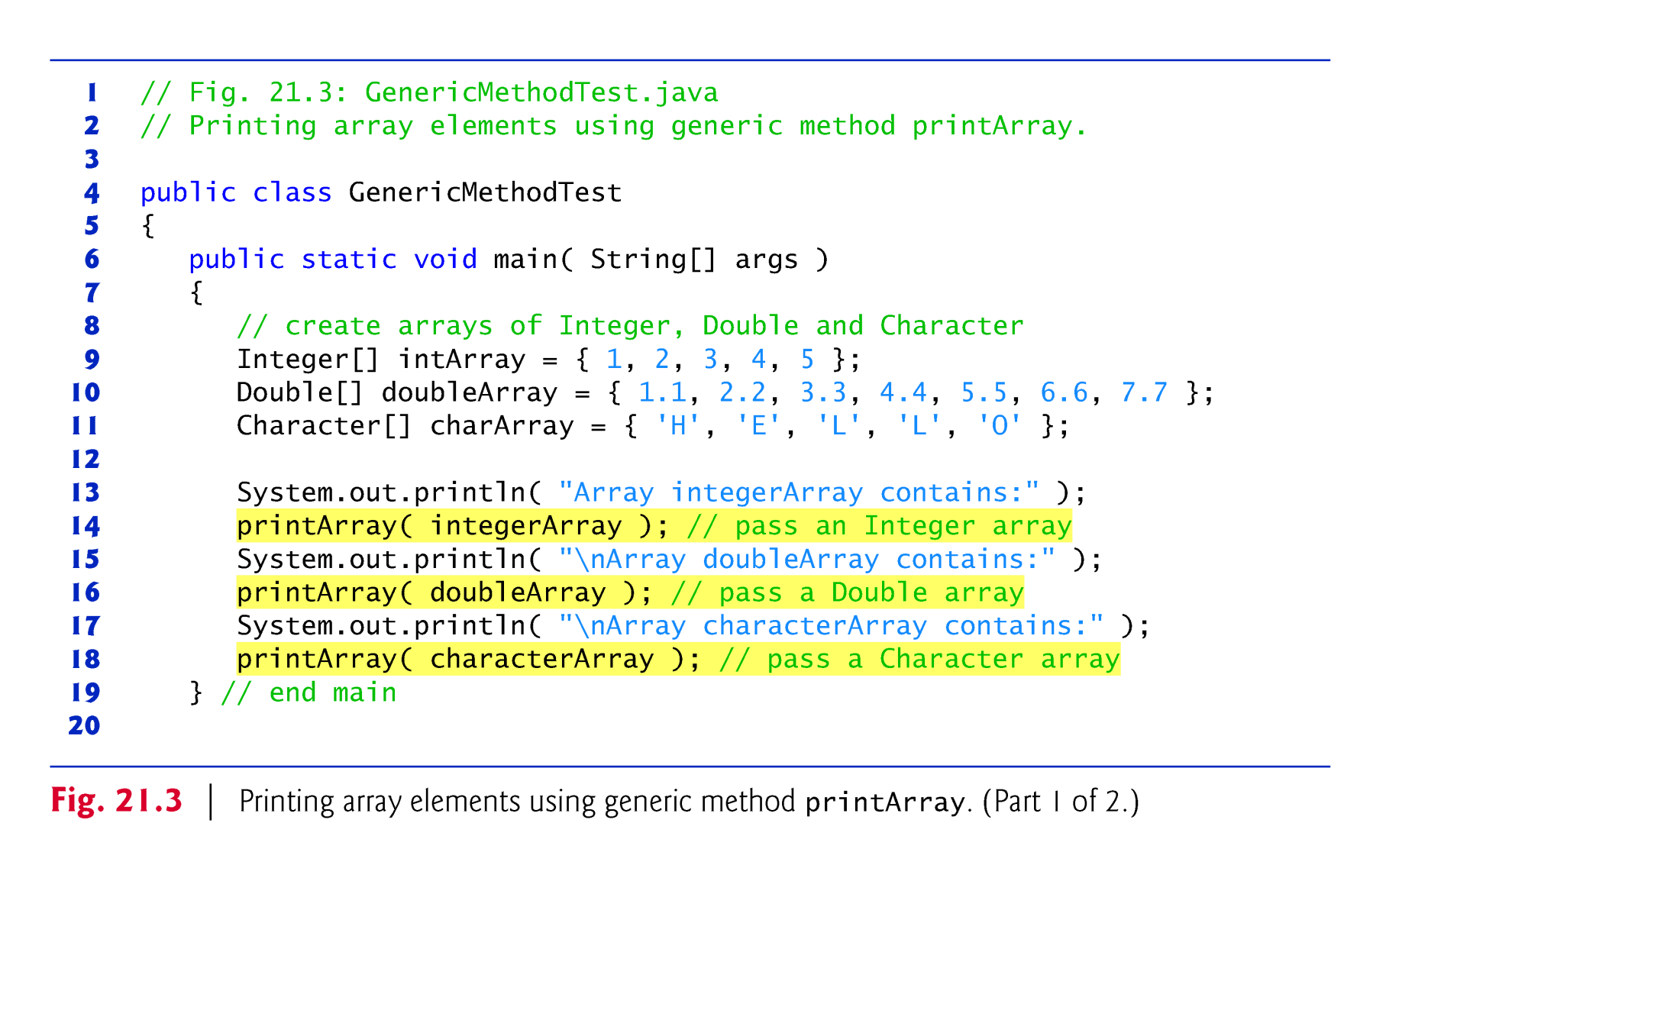

Slide 11
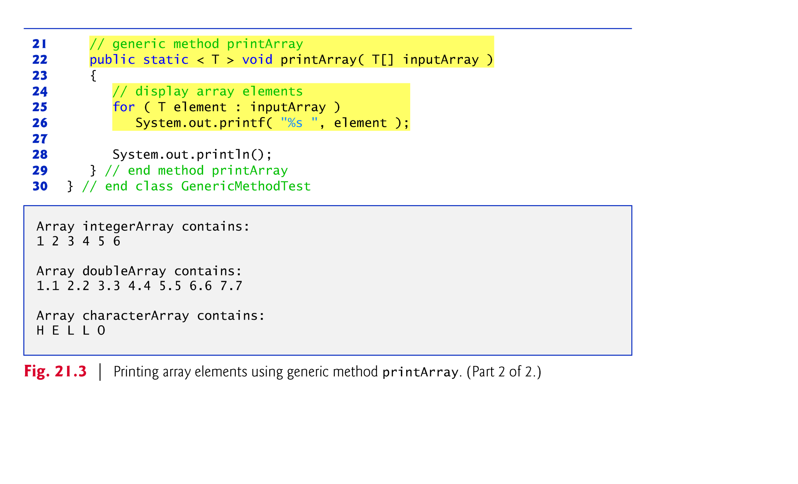

Slide 12
20.3 Generic Methods: Implementation and Compile-Time Translation (cont.)
All generic method declarations have a type-parameter section delimited by angle brackets (< and >) that precedes the method’s return type (< T > in this example).
Each type-parameter section contains one or more type parameters (also called formal type parameters), separated by commas.
A type parameter, also known as a type variable, is an identifier that specifies a generic type name.

Slide 13
20.3 Generic Methods: Implementation and Compile-Time Translation (cont.)
Can be used to declare the return type, parameter types and local variable types in a generic method, and act as placeholders for the types of the arguments passed to the generic method (actual type arguments).
A generic method’s body is declared like that of any other method.
Type parameters can represent only reference types —not primitive types.

Slide 14
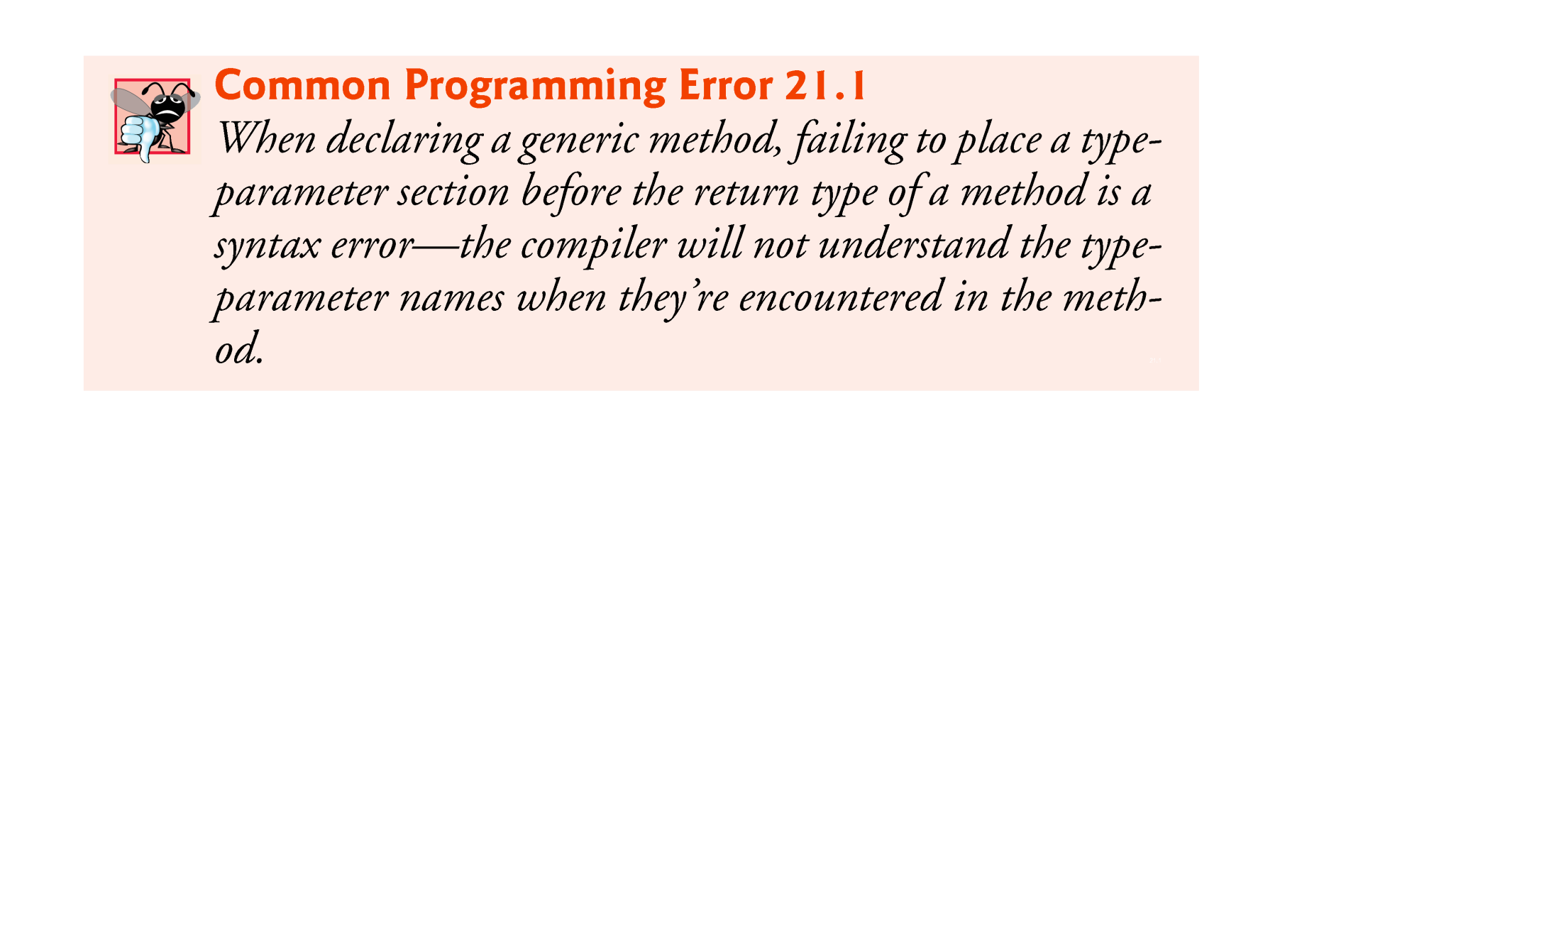

Slide 15
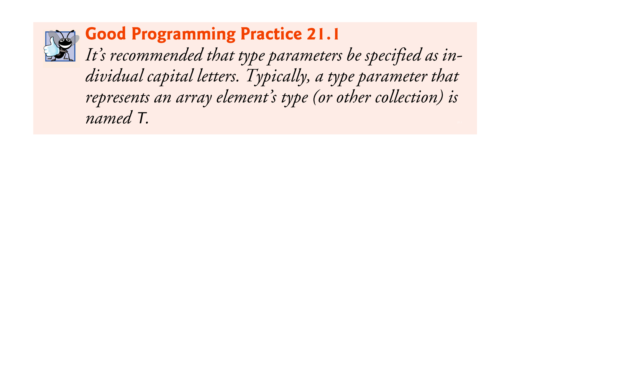

Slide 16
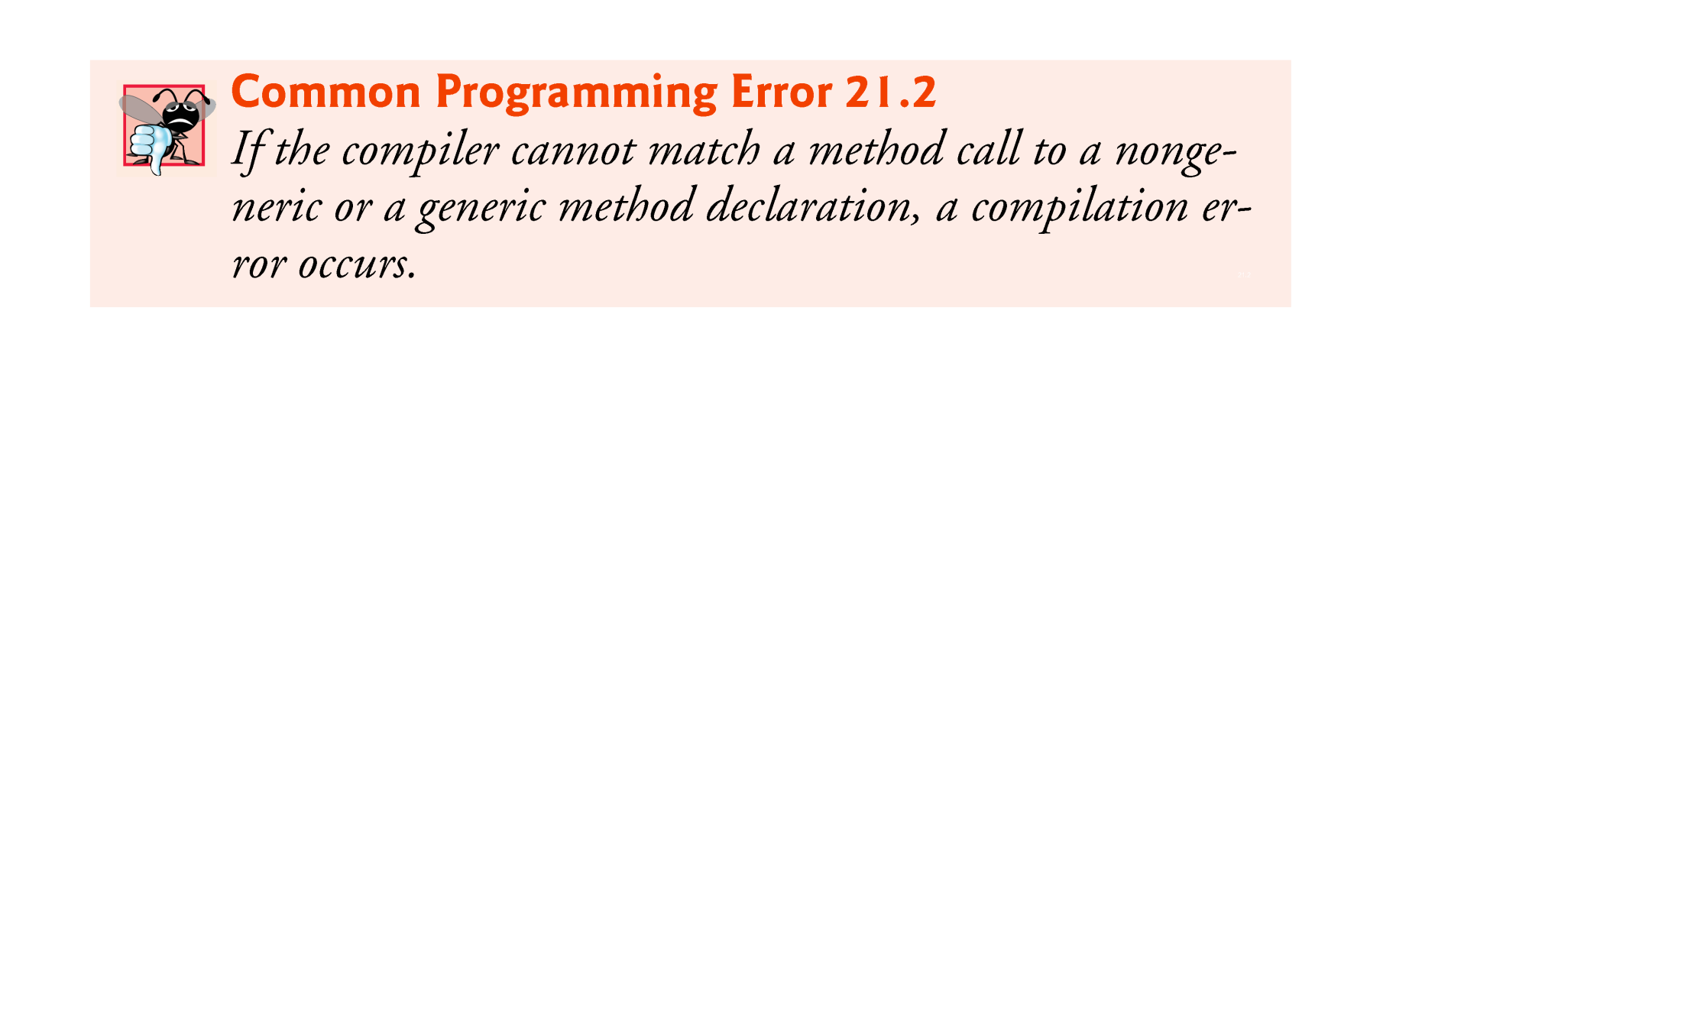

Slide 17


Slide 18
20.3 Generic Methods: Implementation and Compile-Time Translation (cont.)
When the compiler translates generic method printArray into Java bytecodes, it removes the type-parameter section and replaces the type parameters with actual types.
This process is known as erasure.
By default all generic types are replaced with type Object.

Slide 19
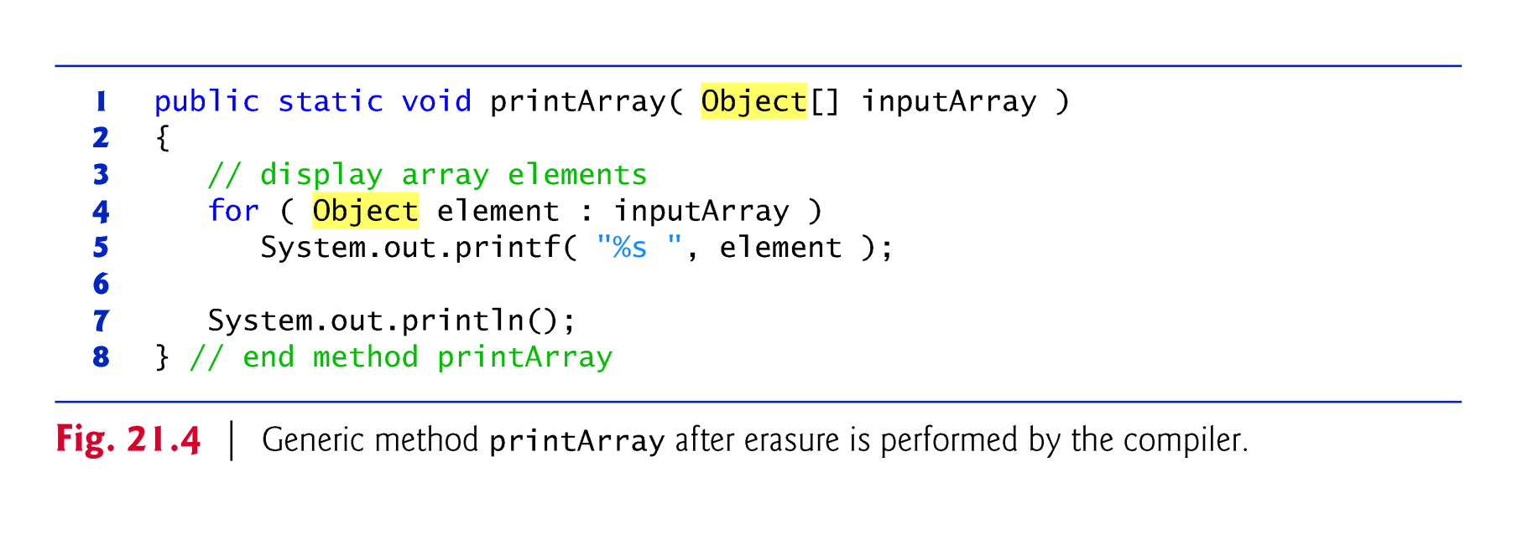

Slide 20
20.4 Additional Compile-Time Translation Issues: Methods That Use a Type Parameter as the Return Type
Generic method maximum determines and return the largest of its three arguments of the same type.
The relational operator > cannot be used with reference types, but it’s possible to compare two objects of the same class if that class implements the generic interface Comparable<T>
All the type-wrapper classes for primitive types implement this interface.
Like generic classes, generic interfaces enable you to specify, with a single interface declaration, a set of related types.

Slide 21
20.4 Additional Compile-Time Translation Issues: Methods That Use a Type Parameter as the Return Type (cont.)
Comparable<T> objects have a compareTo method.
A benefit of implementing interface Comparable<T> is that Comparable<T> objects can be used with the sorting and searching methods of class Collections (package java.util).

Slide 22
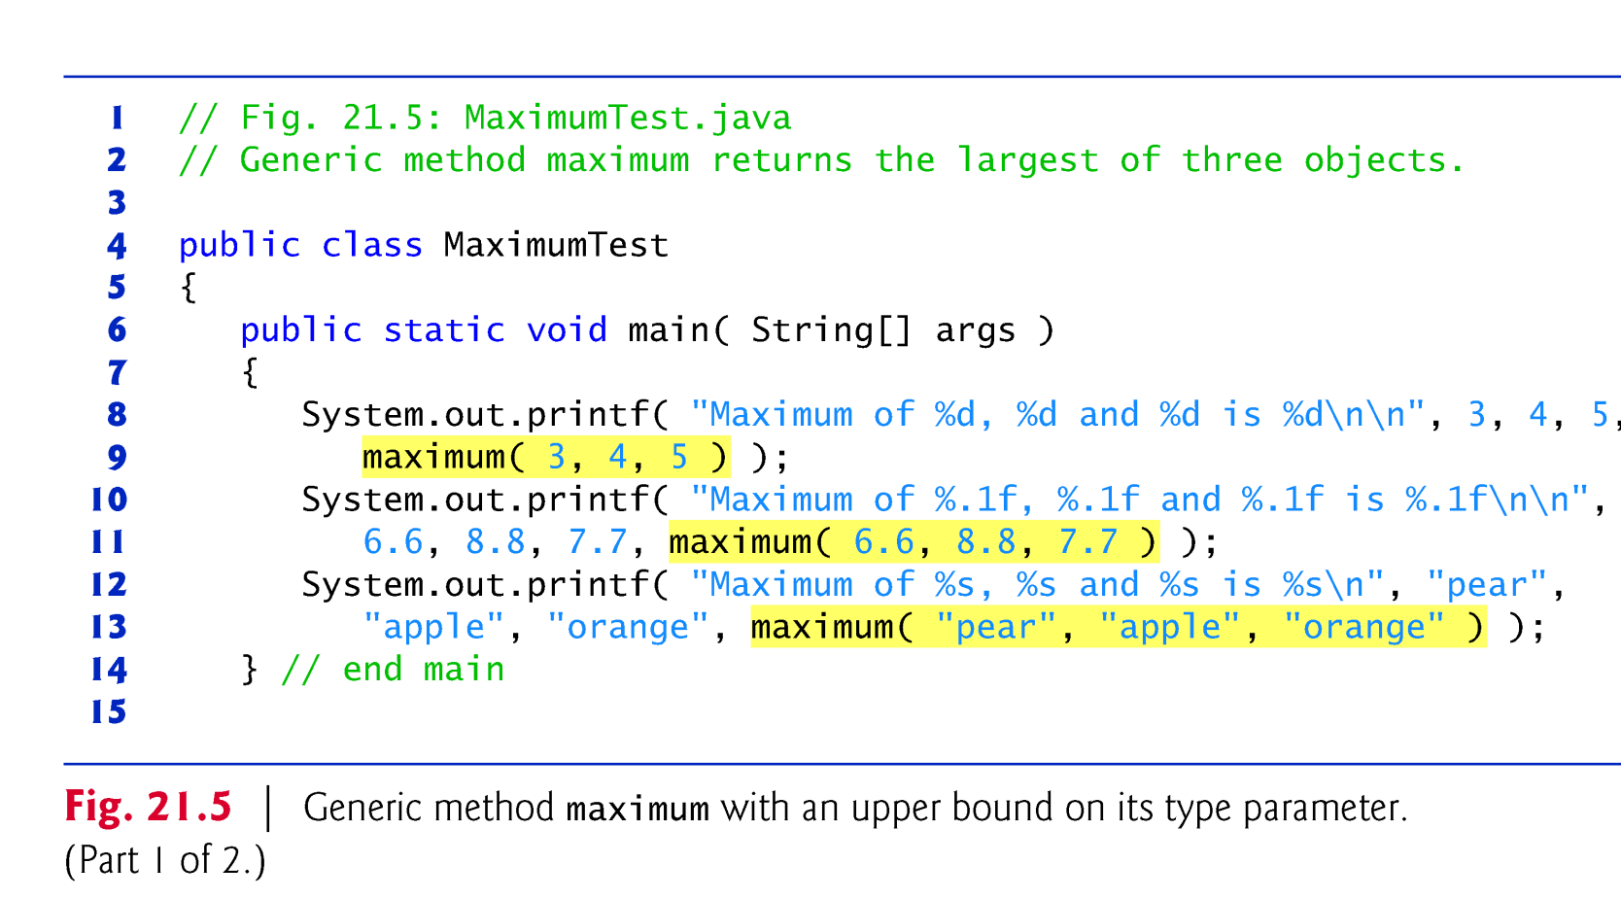

Slide 23
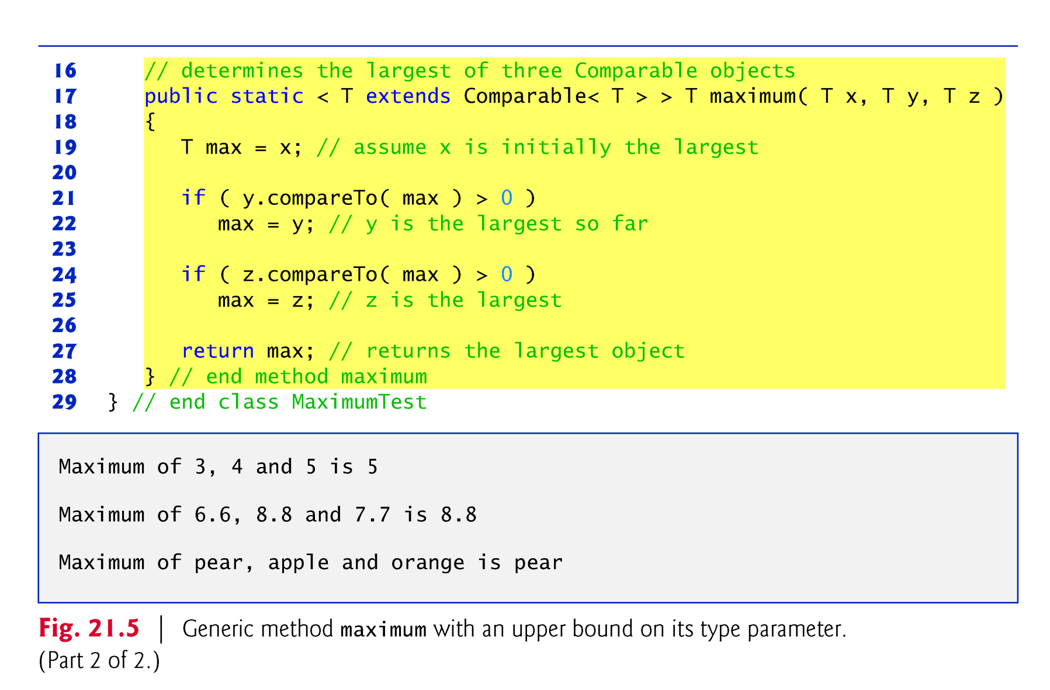

Slide 24
20.4 Additional Compile-Time Translation Issues: Methods That Use a Type Parameter as the Return Type (cont.)
Comparable is known as the upper bound of the type parameter.
By default, Object is the upper bound.
All type parameters are replaced with the upper bound of the type parameter, which is specified in the type-parameter section.

Slide 25
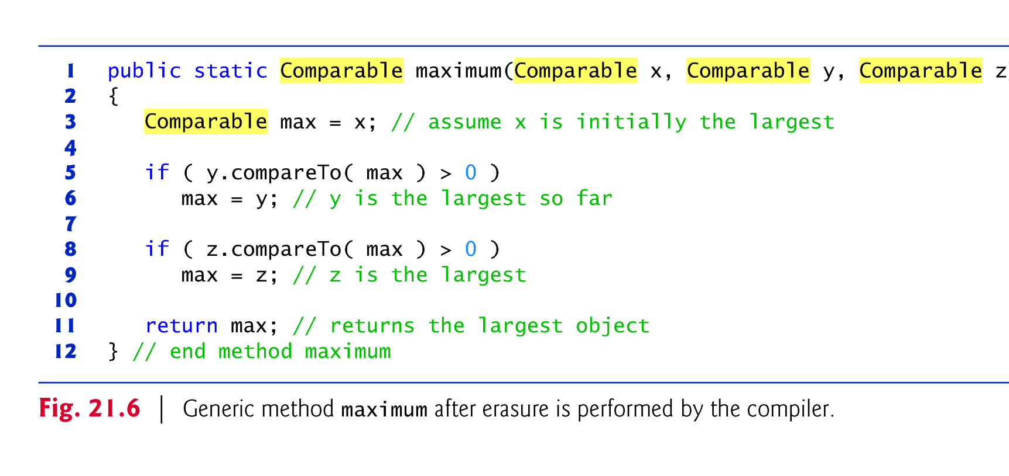

Slide 26
20.5 Overloading Generic Methods
A generic method may be overloaded.
A class can provide two or more generic methods that specify the same method name but different method parameters.
A generic method can also be overloaded by nongeneric methods.
When the compiler encounters a method call, it searches for the method declaration that most precisely matches the method name and the argument types specified in the call.

Slide 27
20.6 Generic Classes
The concept of a data structure, such as a stack, can be understood independently of the element type it manipulates.
Generic classes provide a means for describing the concept of a stack (or any other class) in a type-independent manner.
These classes are known as parameterized classes or parameterized types because they accept one or more type parameters.

Slide 28
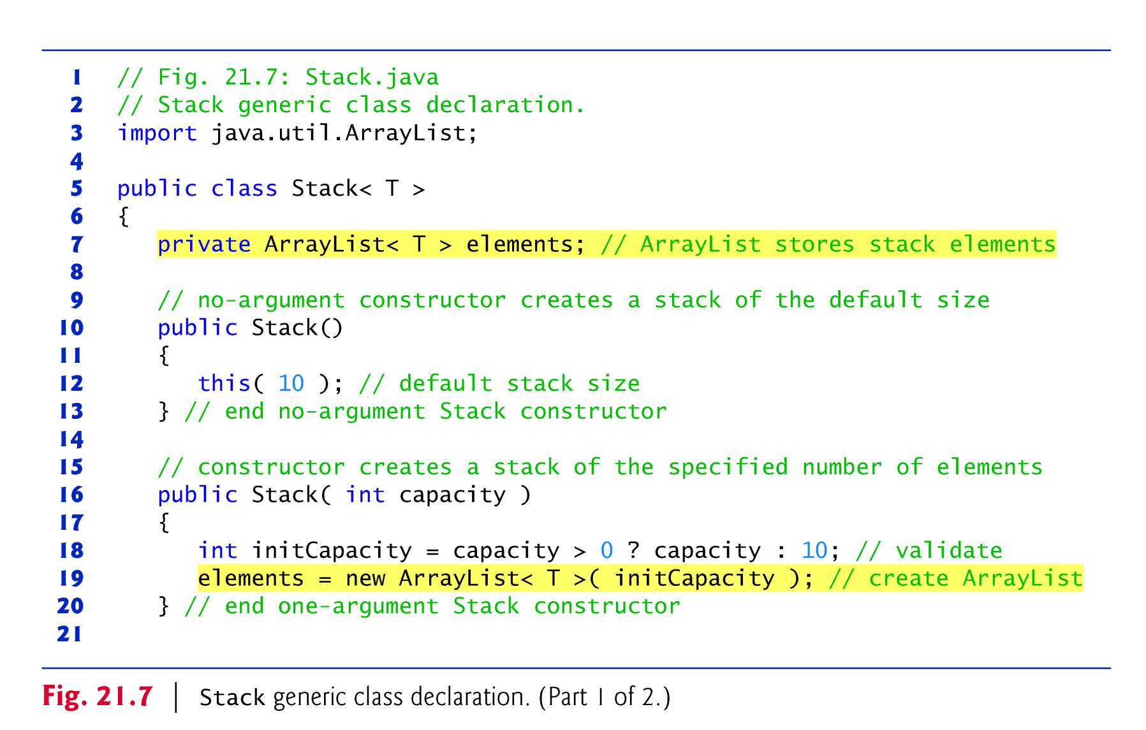

Slide 29
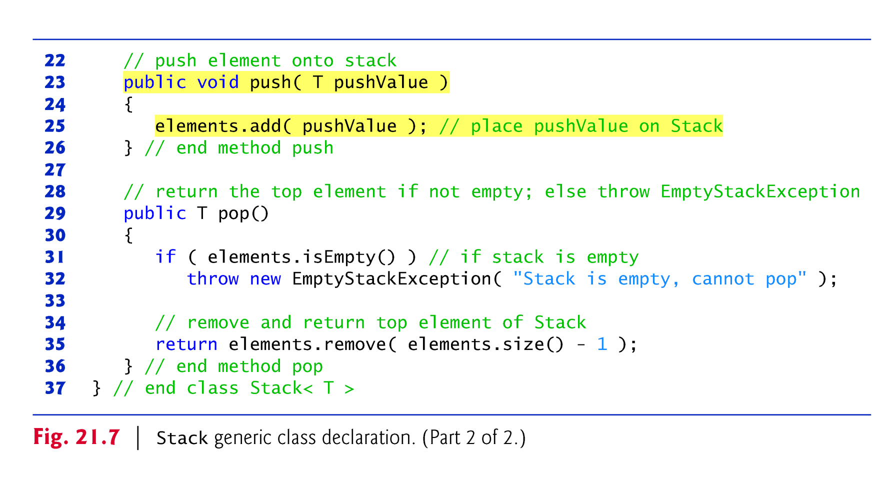

Slide 30
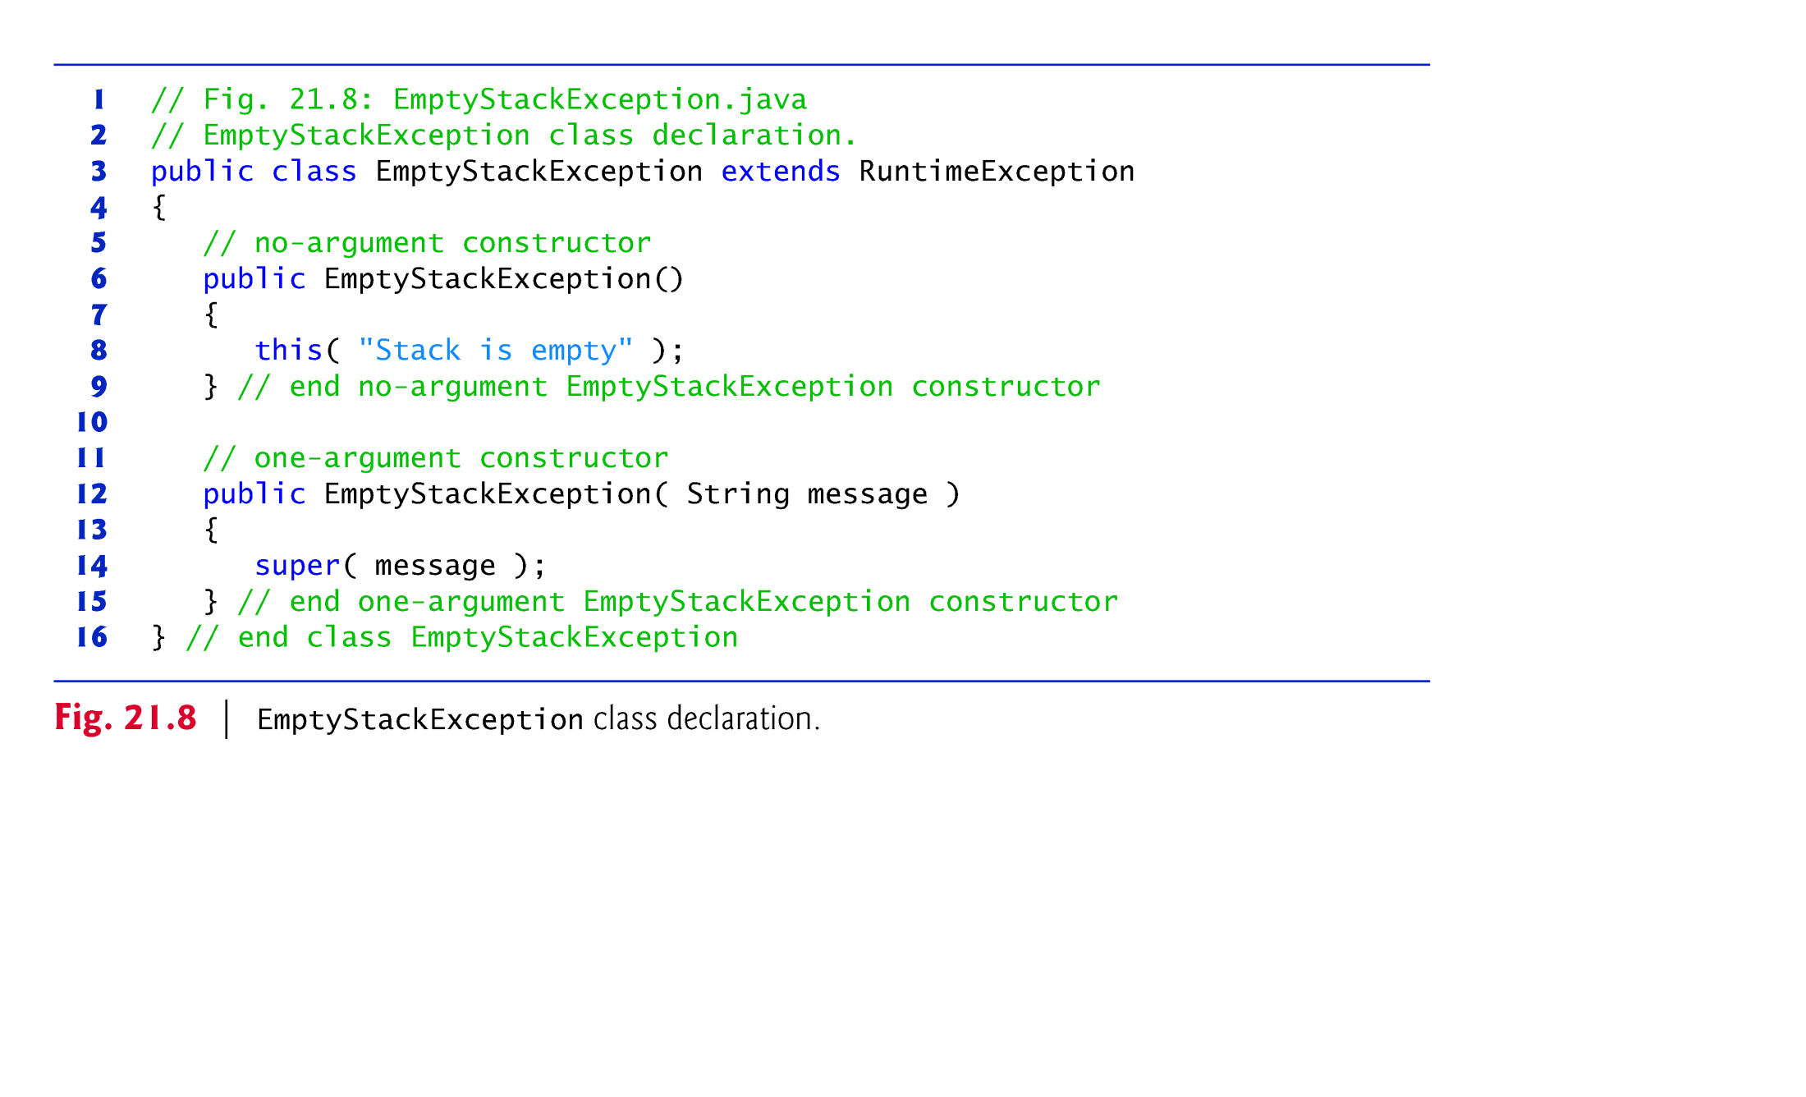

Slide 31
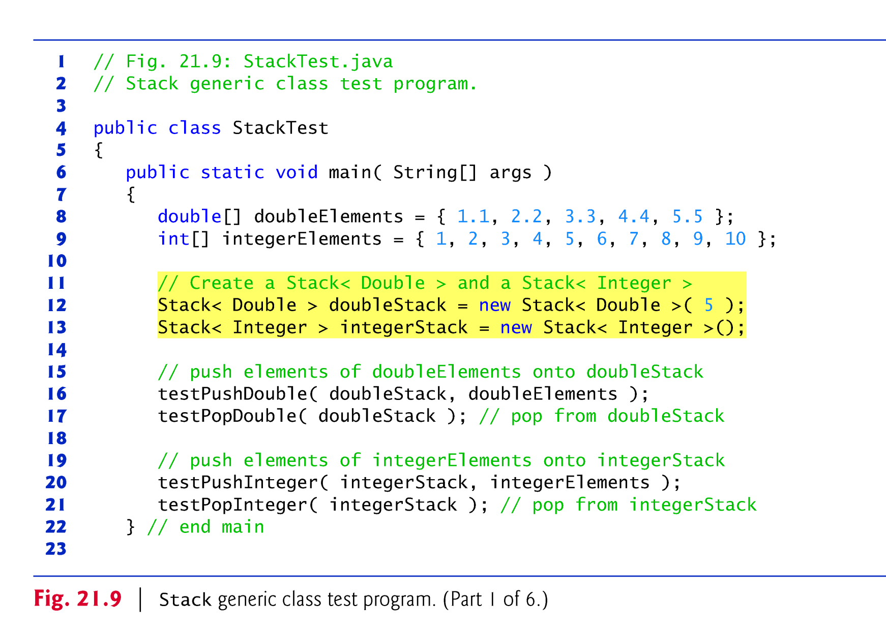

Slide 32
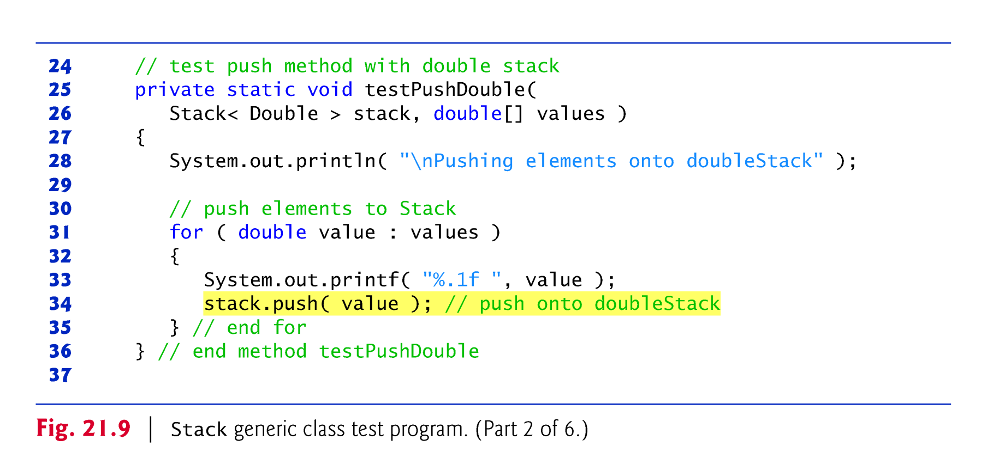

Slide 33
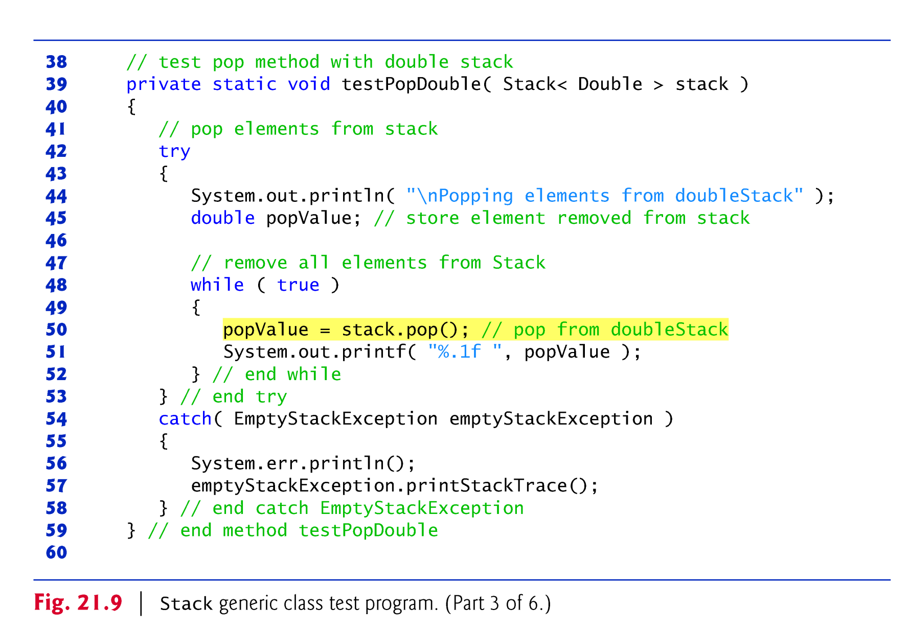

Slide 34
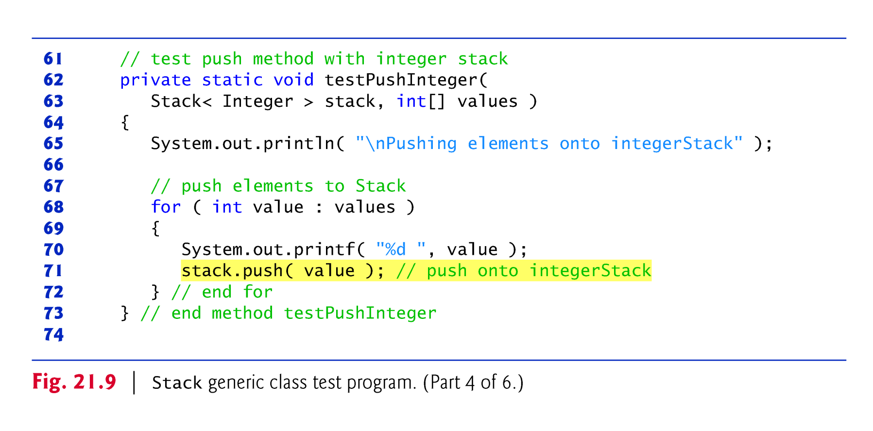

Slide 35
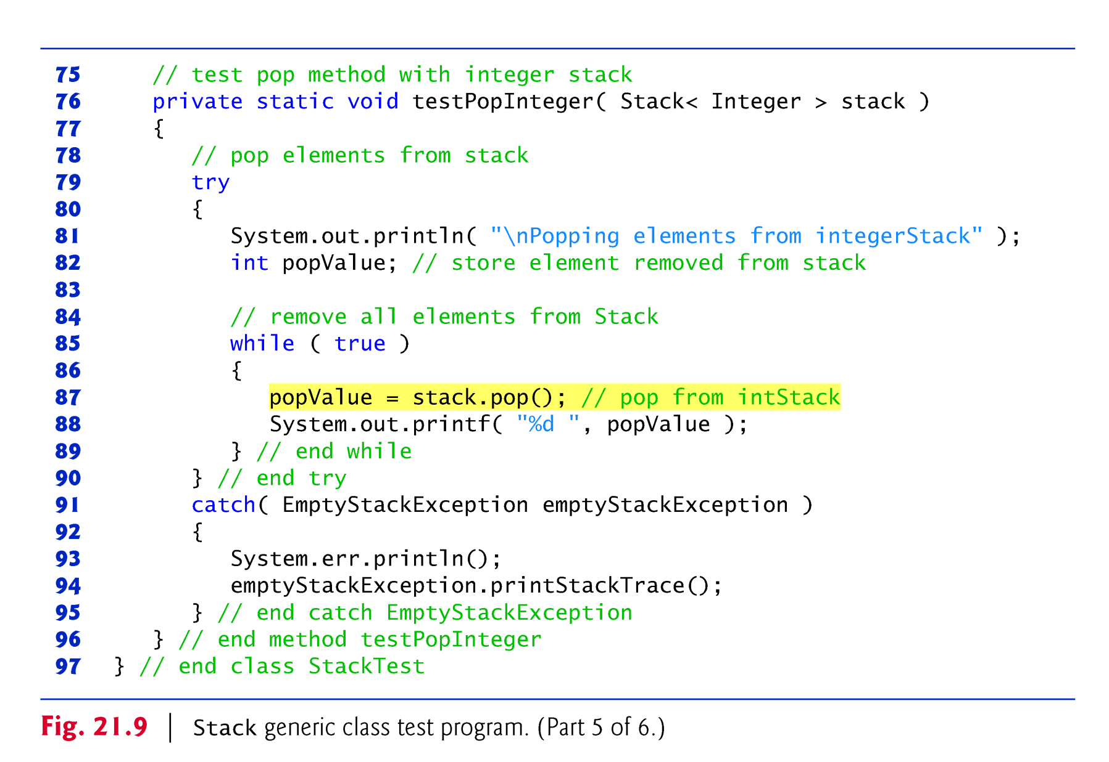

Slide 36
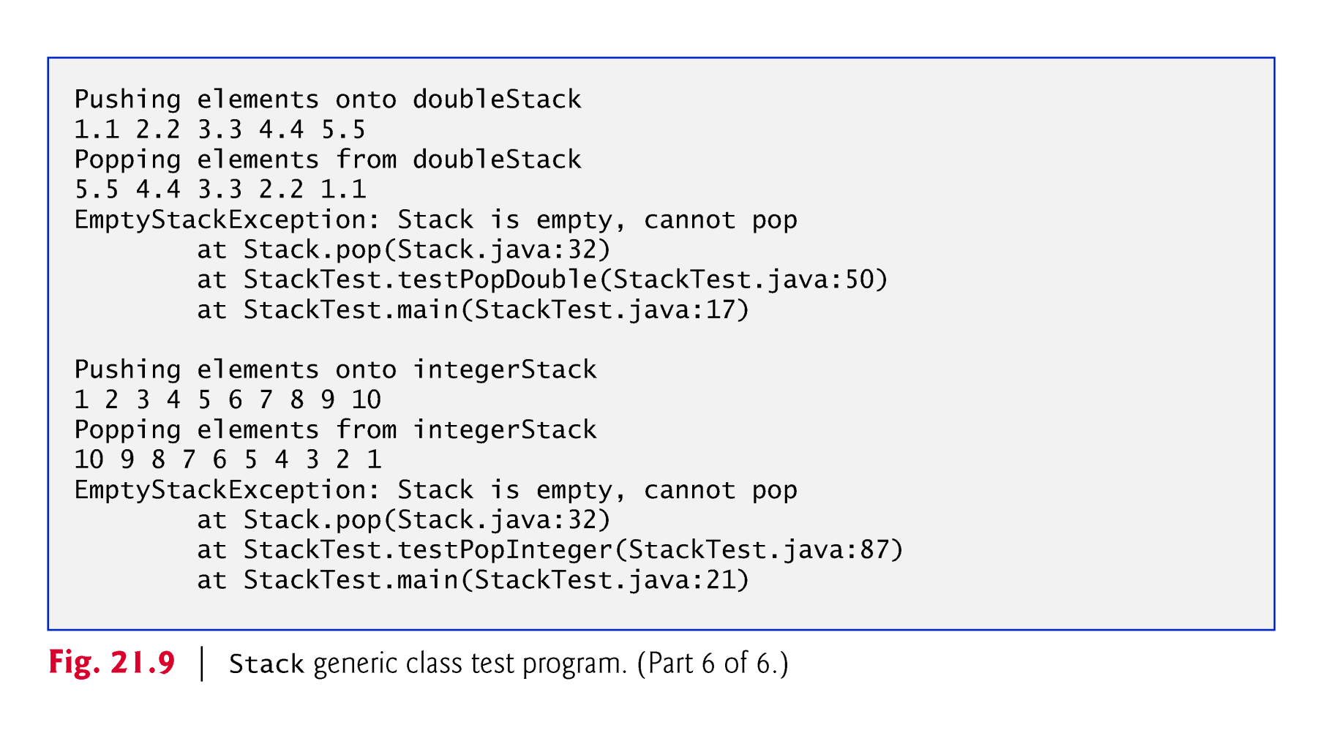

Slide 37
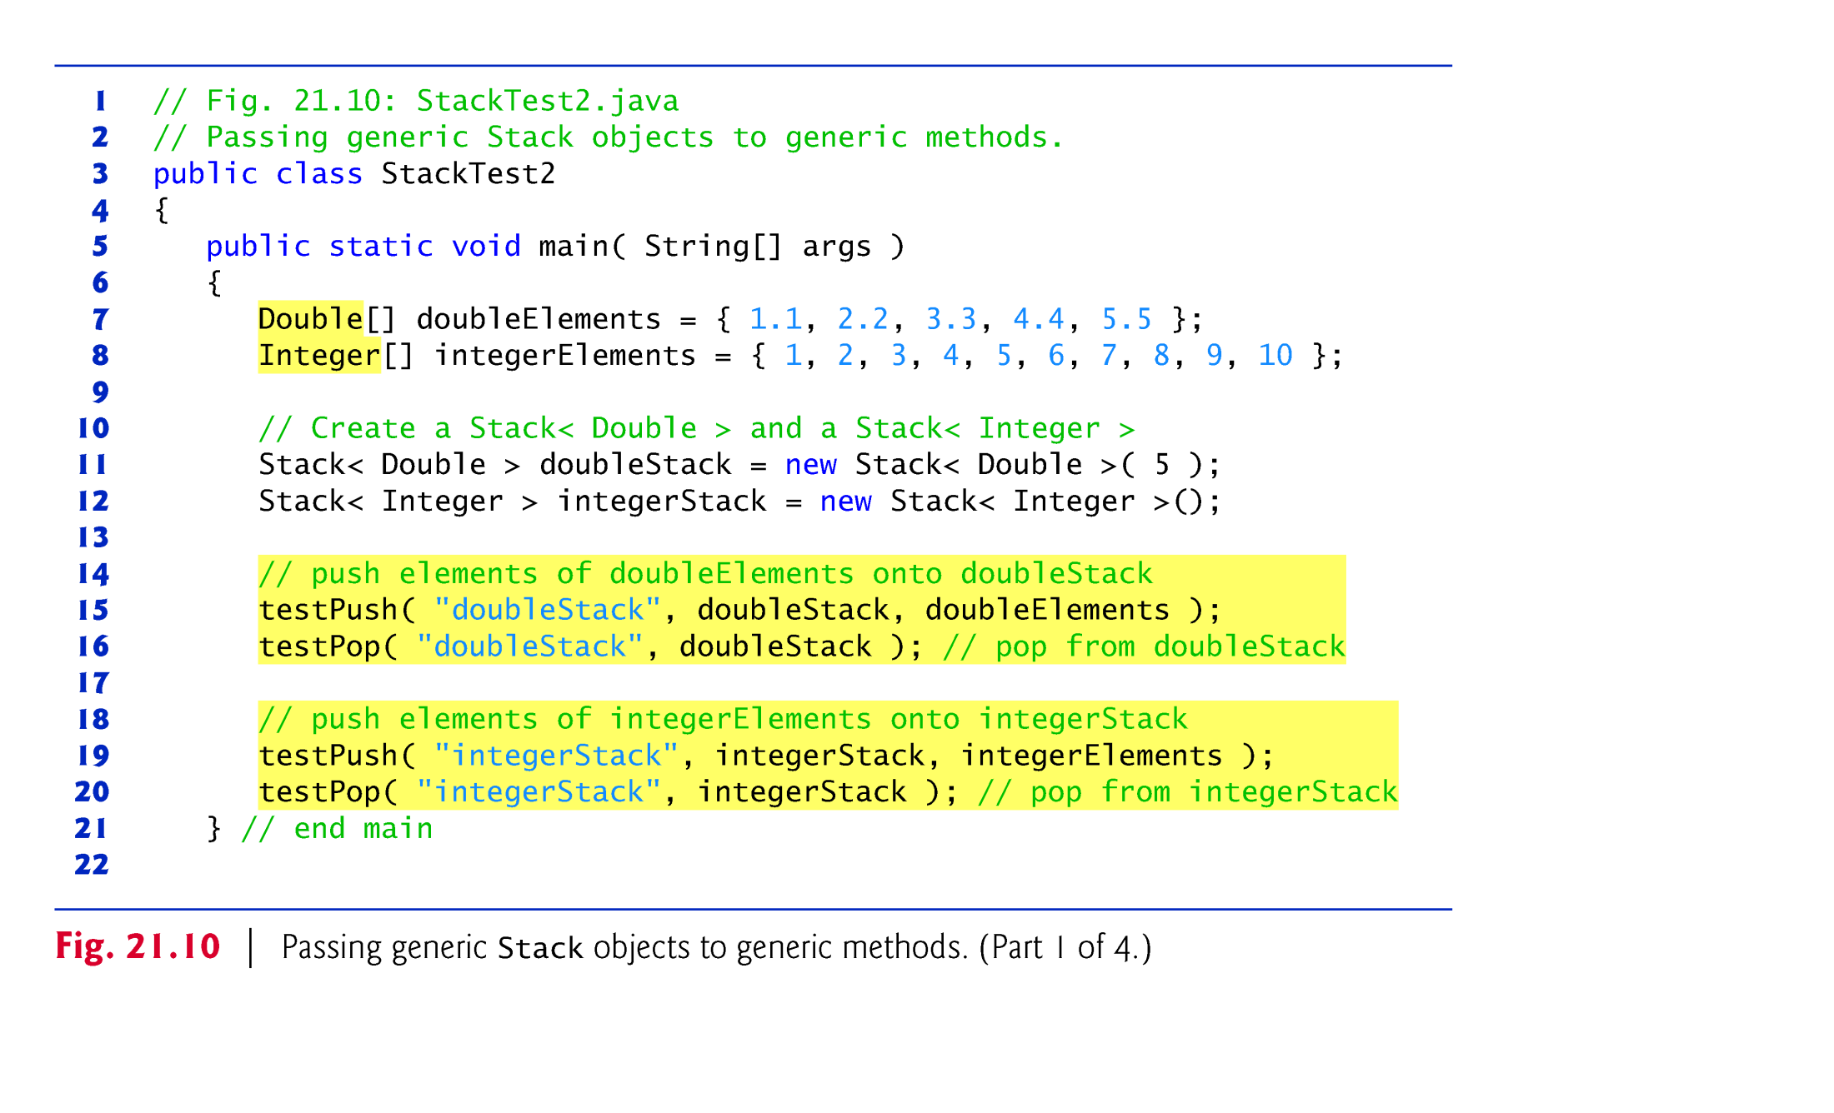

Slide 38
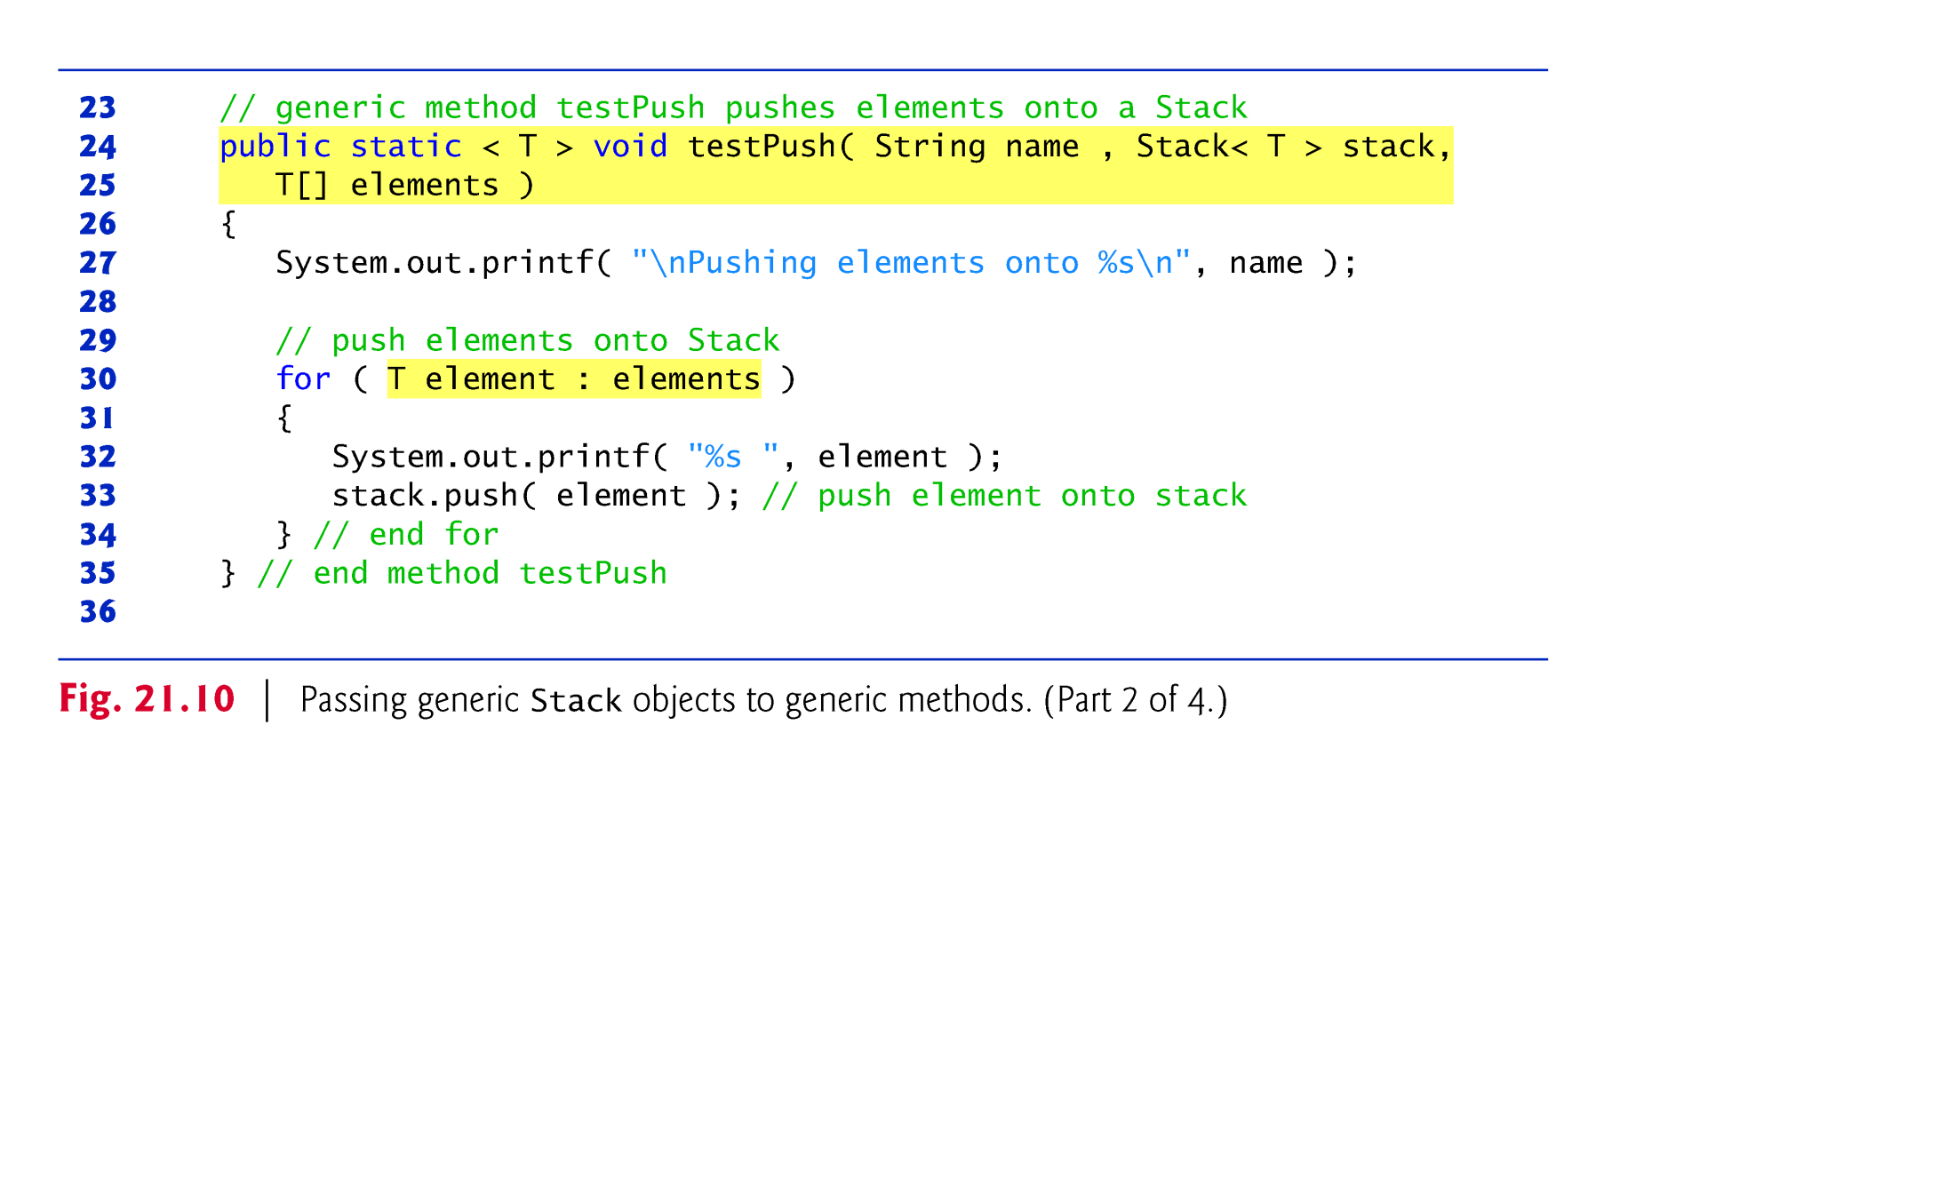

Slide 39
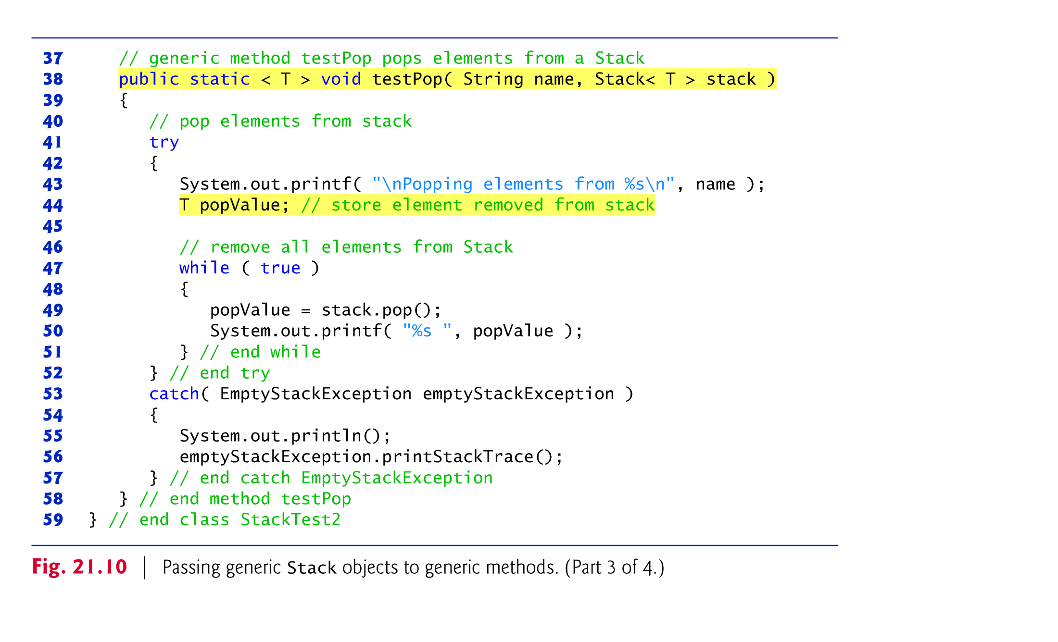

Slide 40
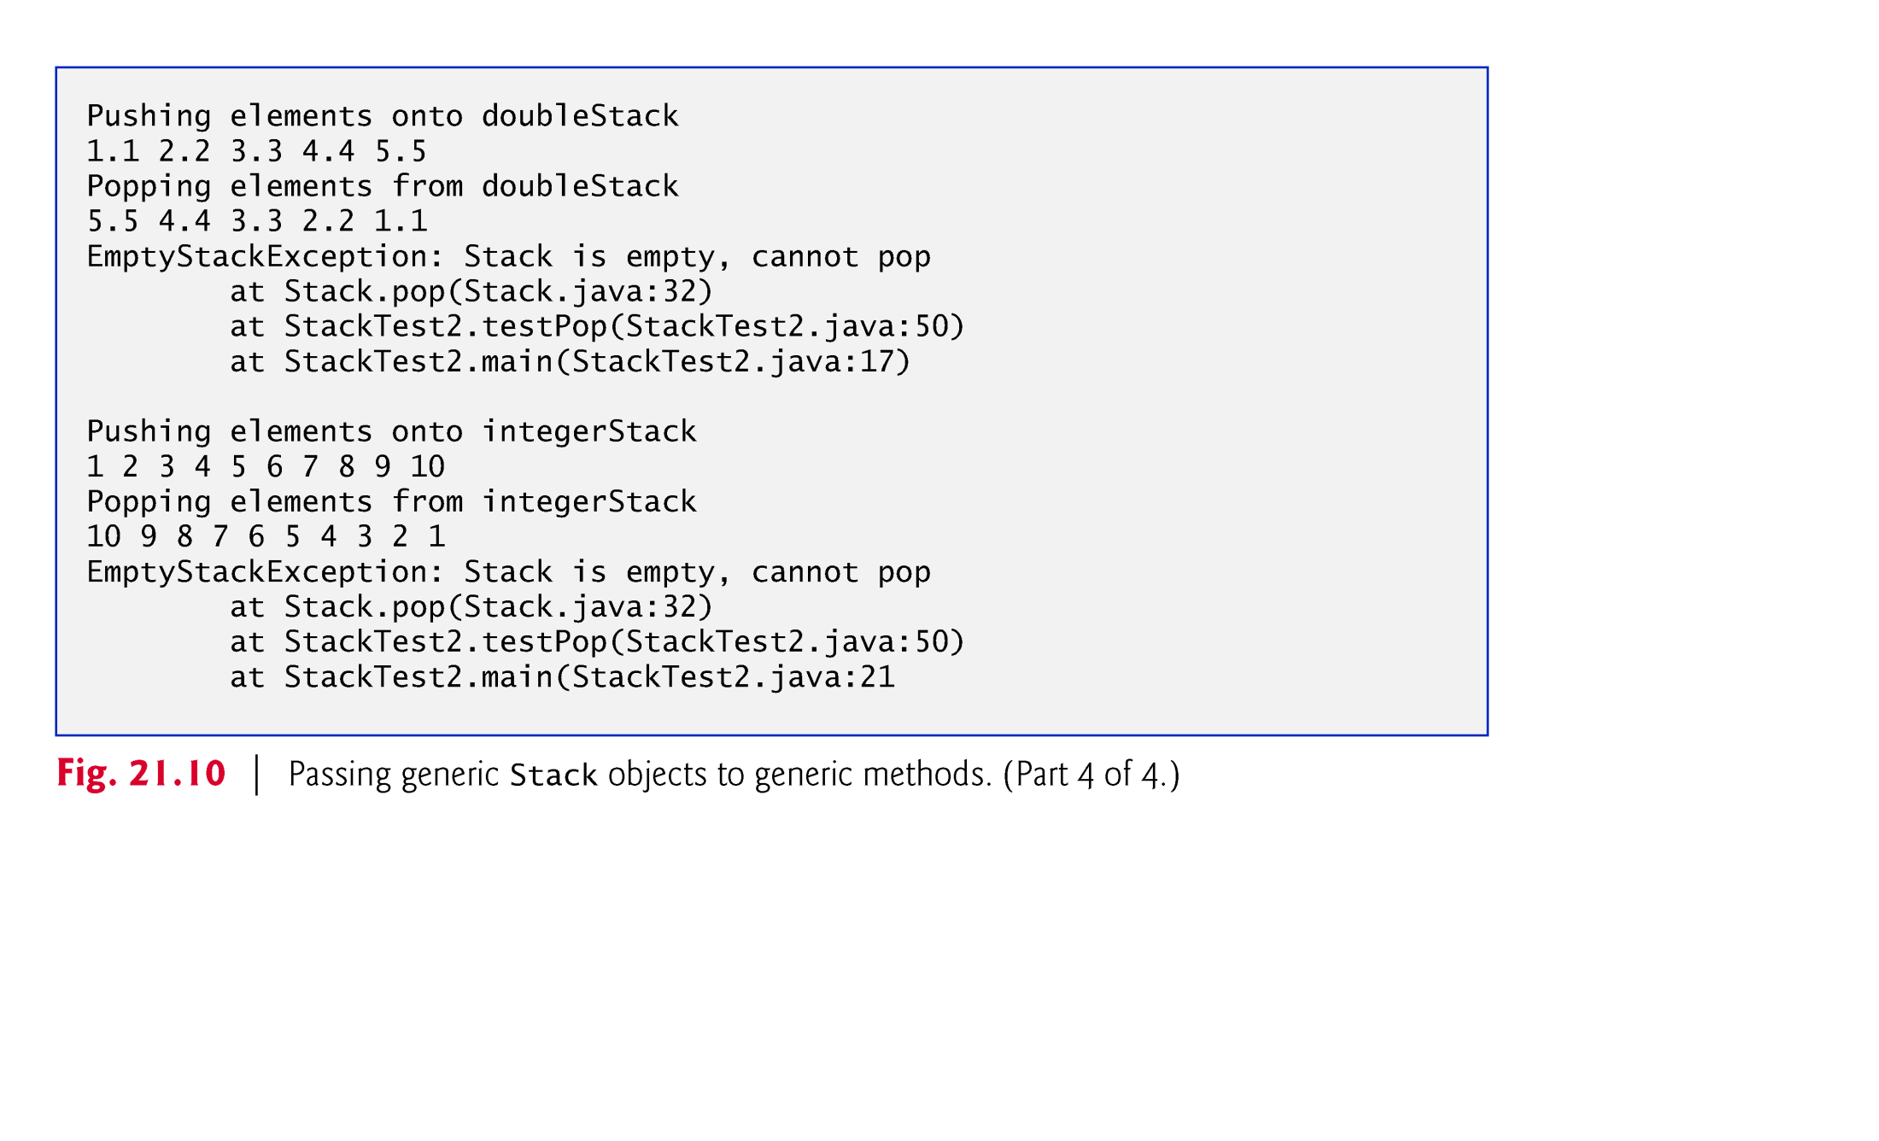

Slide 41
20.8 Raw Types
It’s also possible to instantiate generic class Stack without specifying a type argument, as follows:
// no type-argument specified Stack objectStack = new Stack( 5 );
objectStack is said to have a raw type
The compiler implicitly uses type Object throughout the generic class for each type argument.
The preceding statement creates a Stack that can store objects of any type.
Important for backward compatibility with prior versions of Java.
Raw-type operations are unsafe and could lead to exceptions.

Slide 42
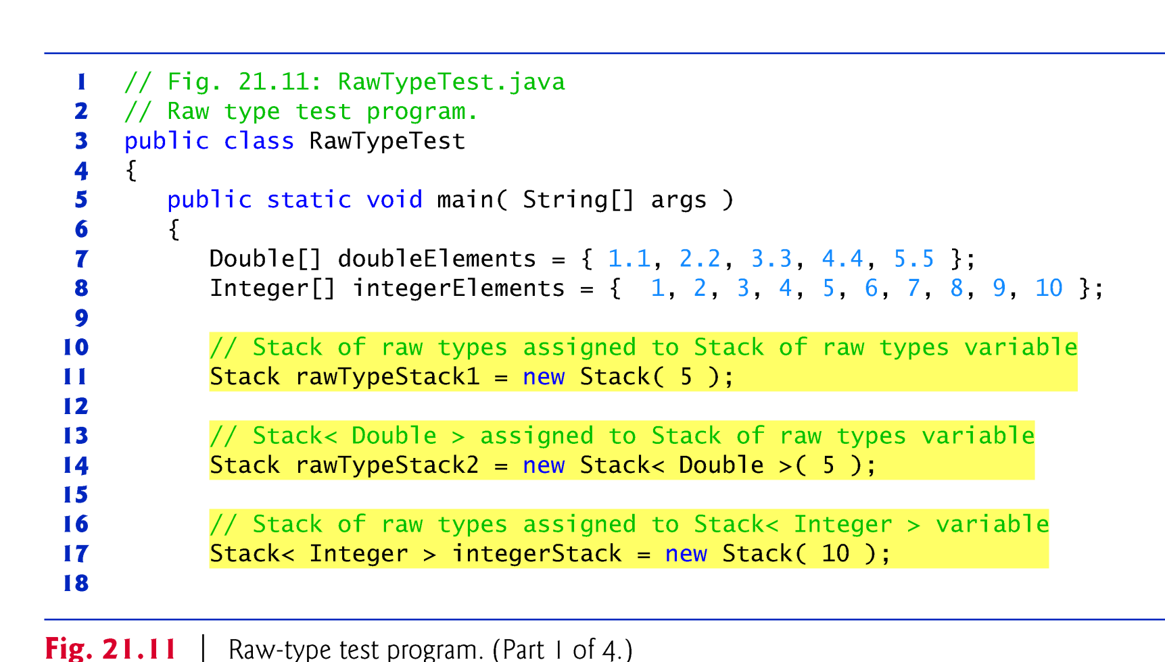

Slide 43
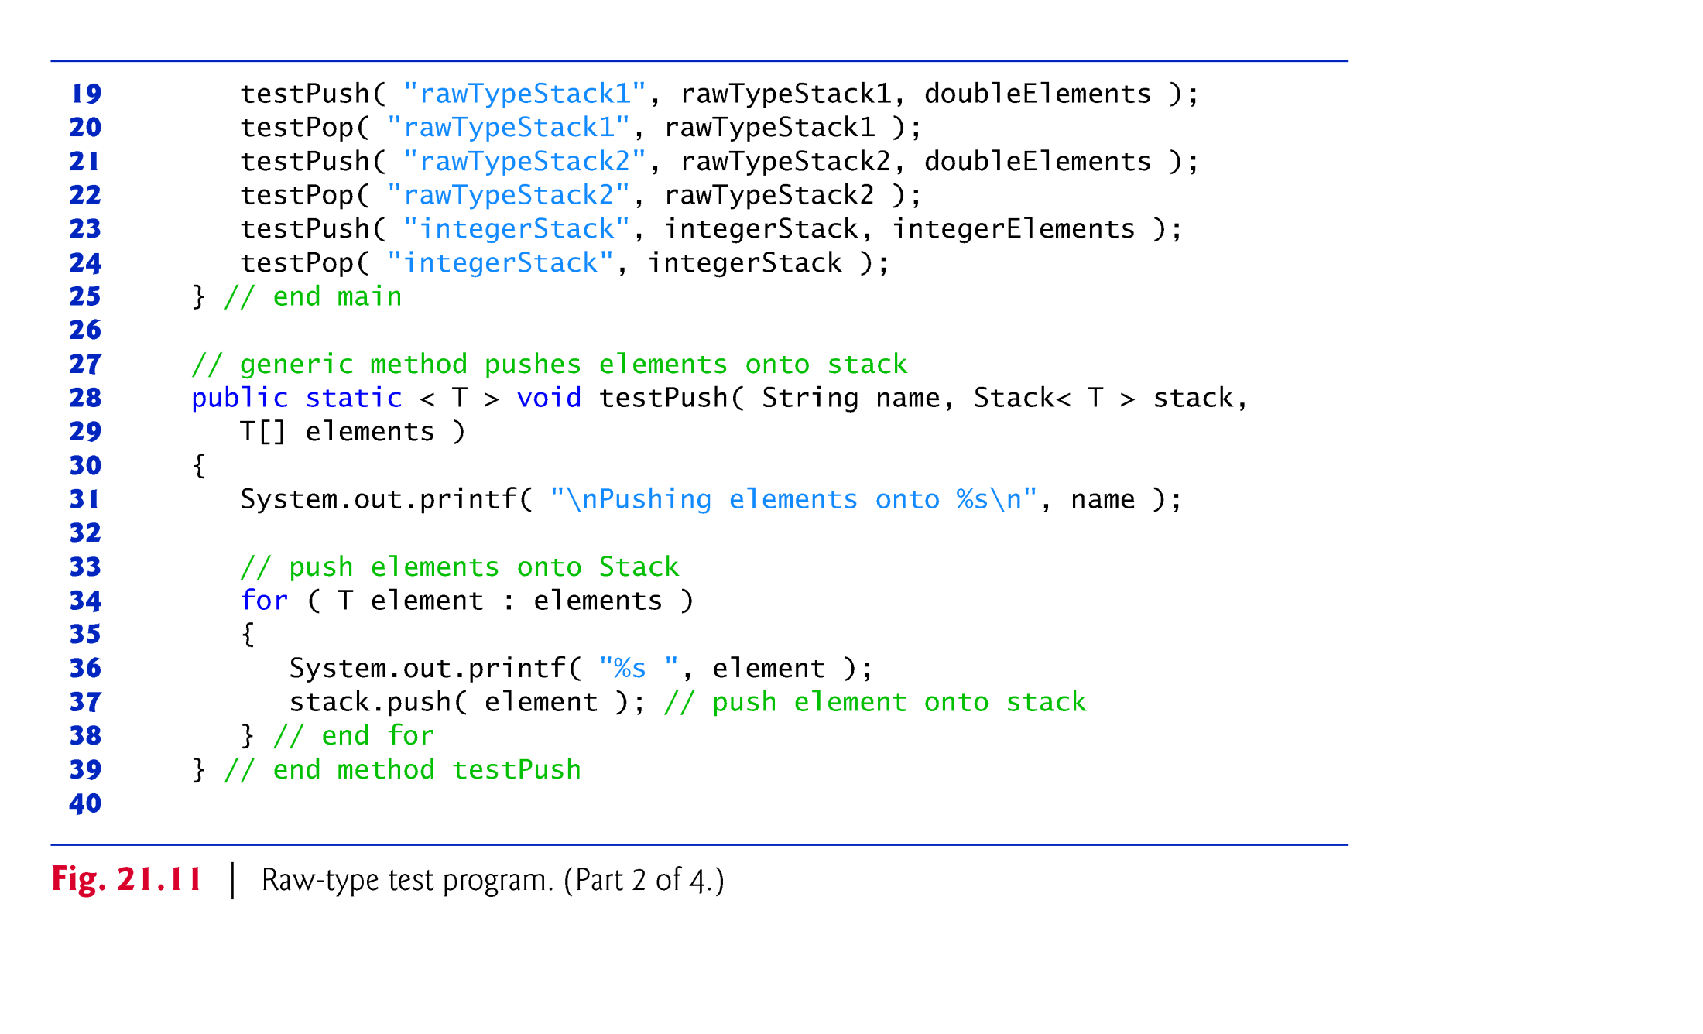

Slide 44
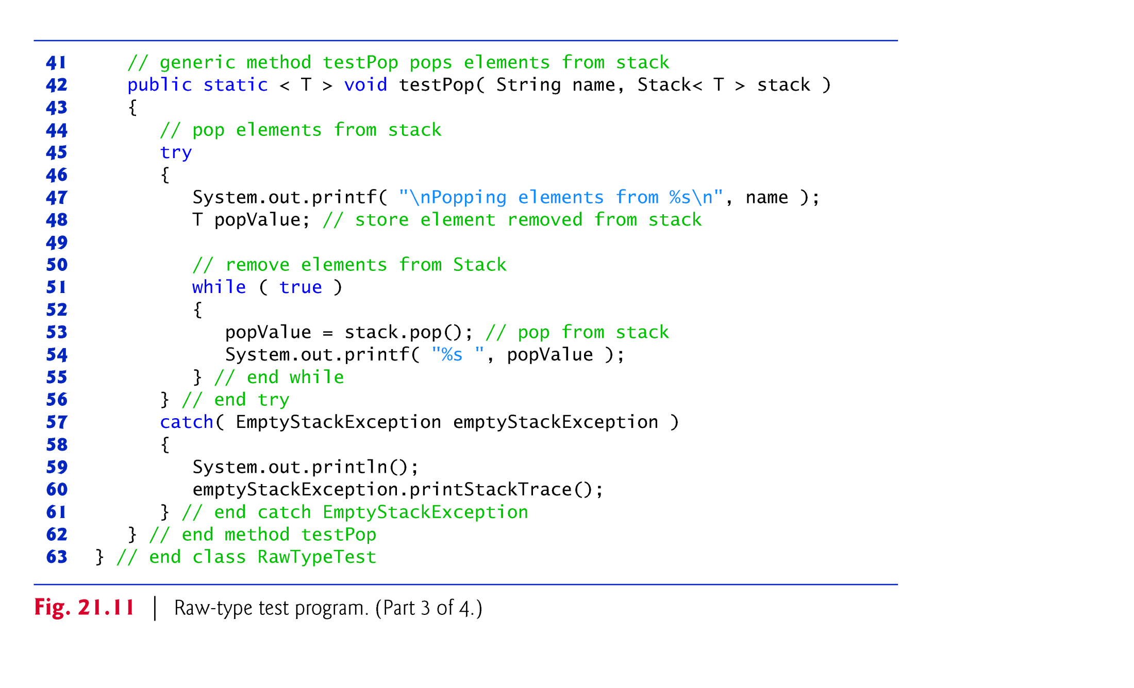

Slide 45
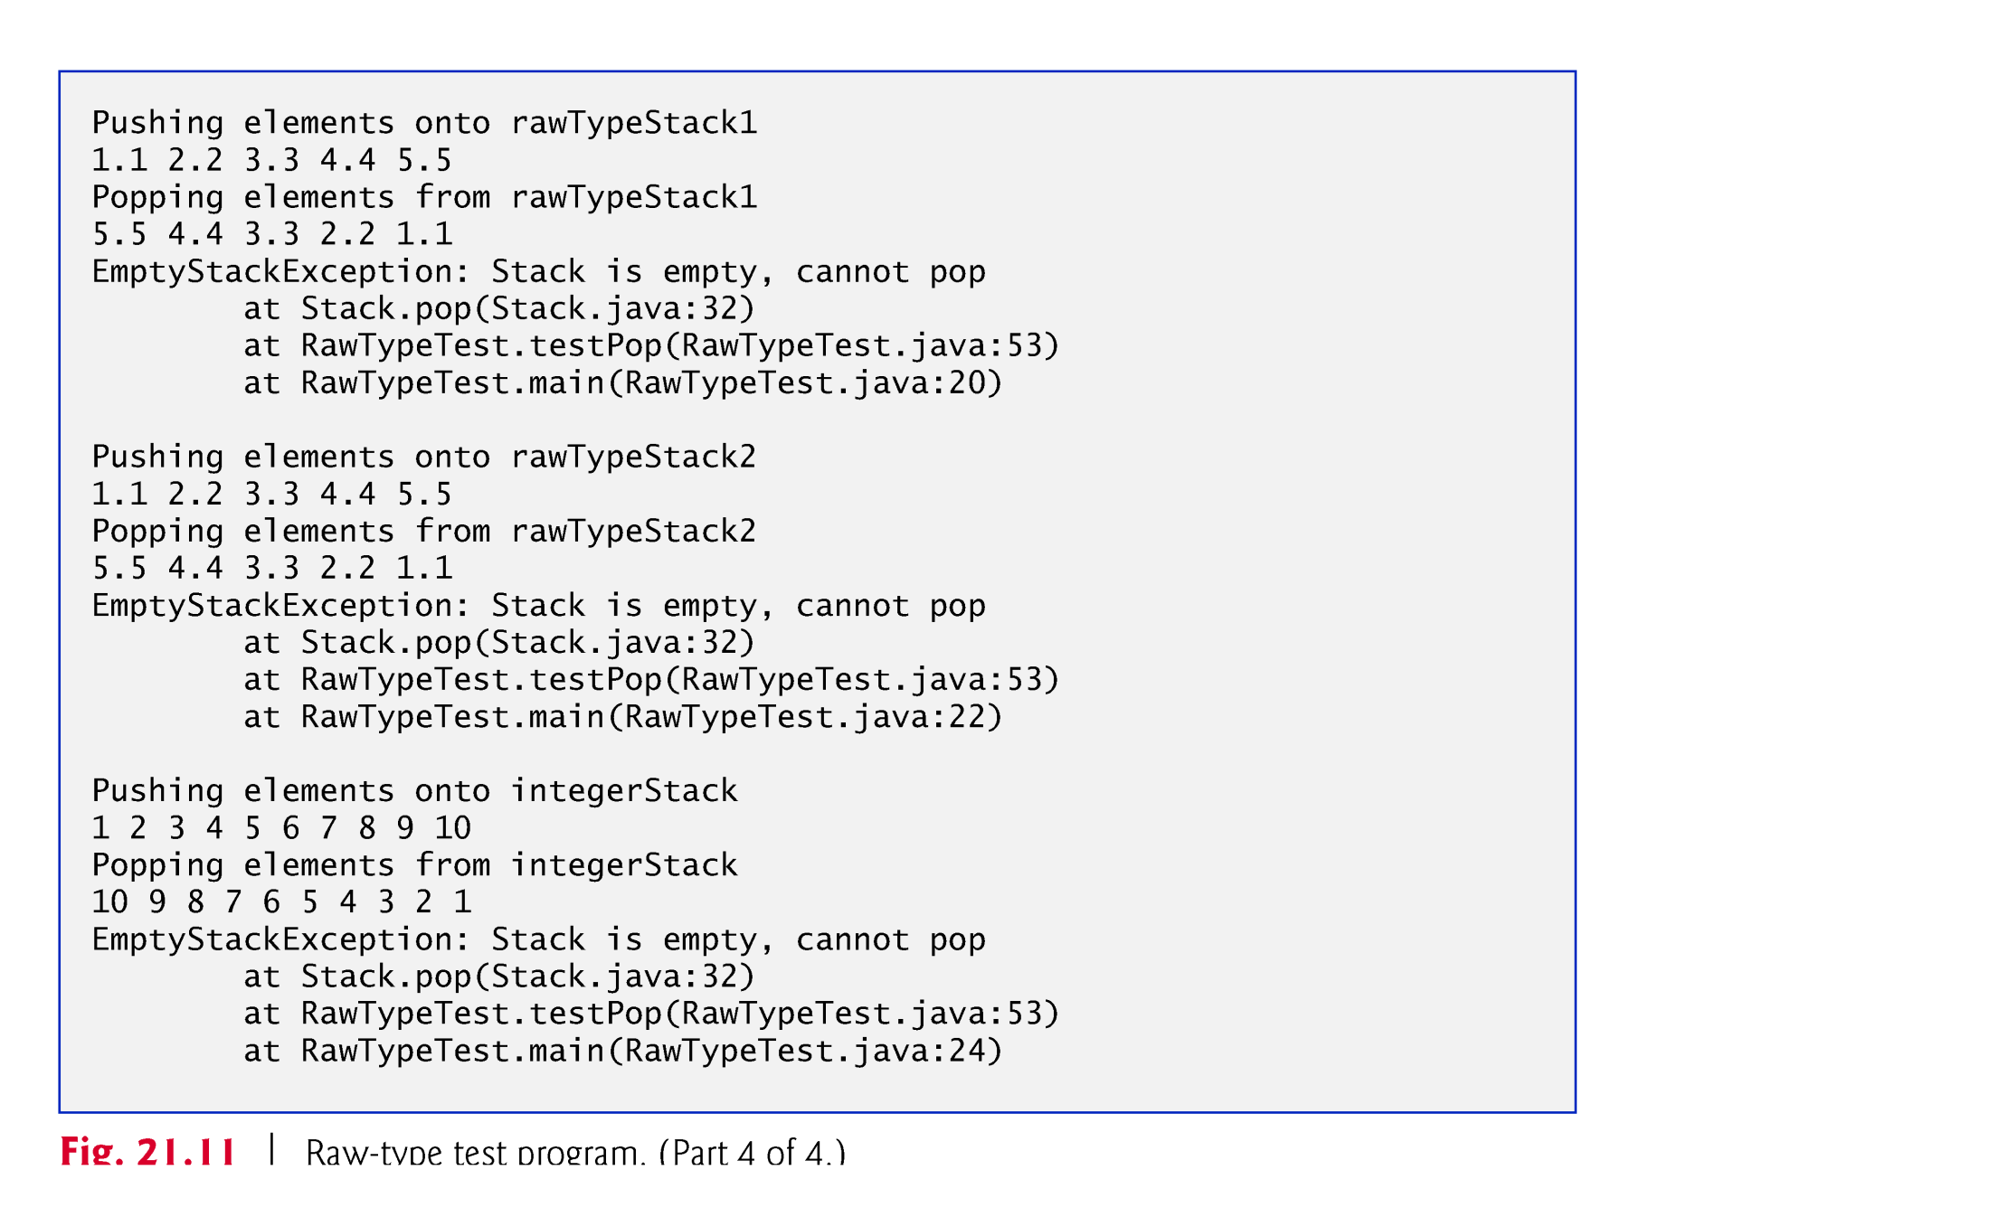

Slide 46
20.7 Raw Types (cont.)
Figure 20.12 shows the warning messages generated by the compiler when the file RawTypeTest.java (Fig. 20.11) is compiled with the -Xlint:unchecked option, which provides more information about potentially unsafe operations in code that uses generics.

Slide 47
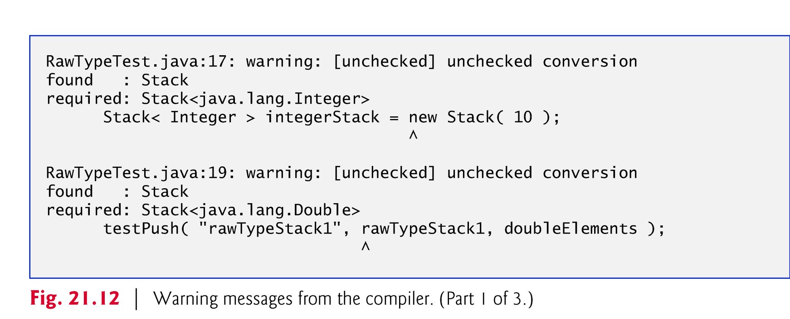

Slide 48
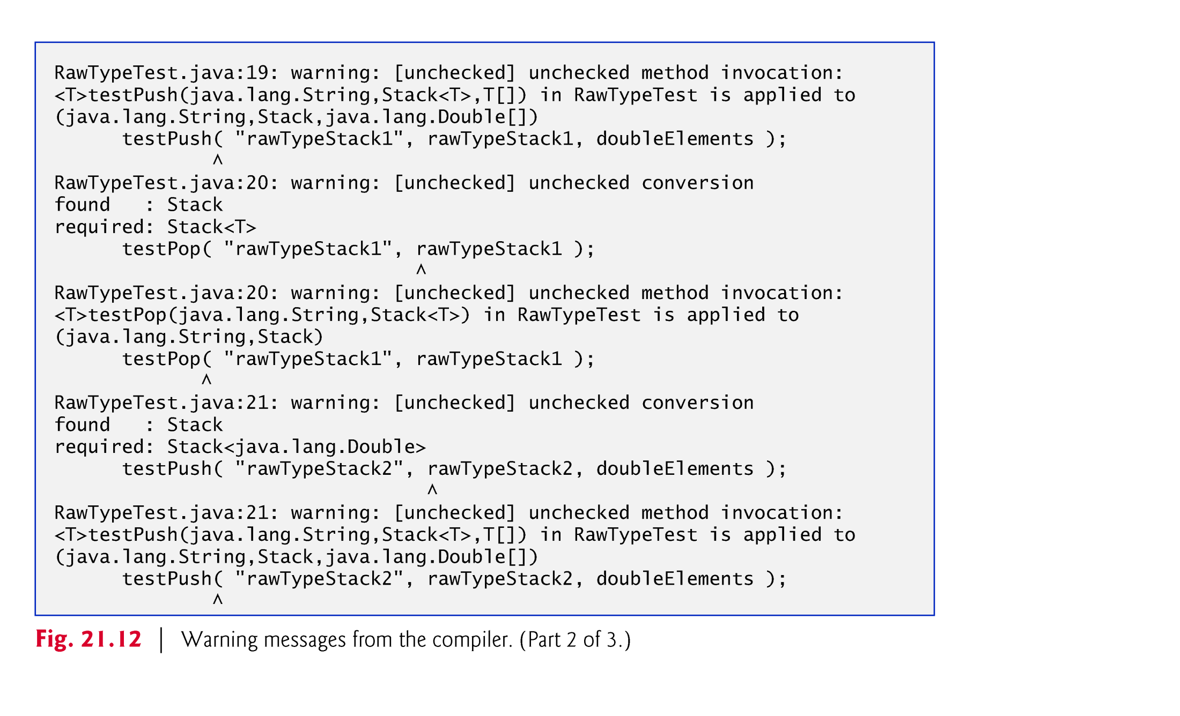

Slide 49
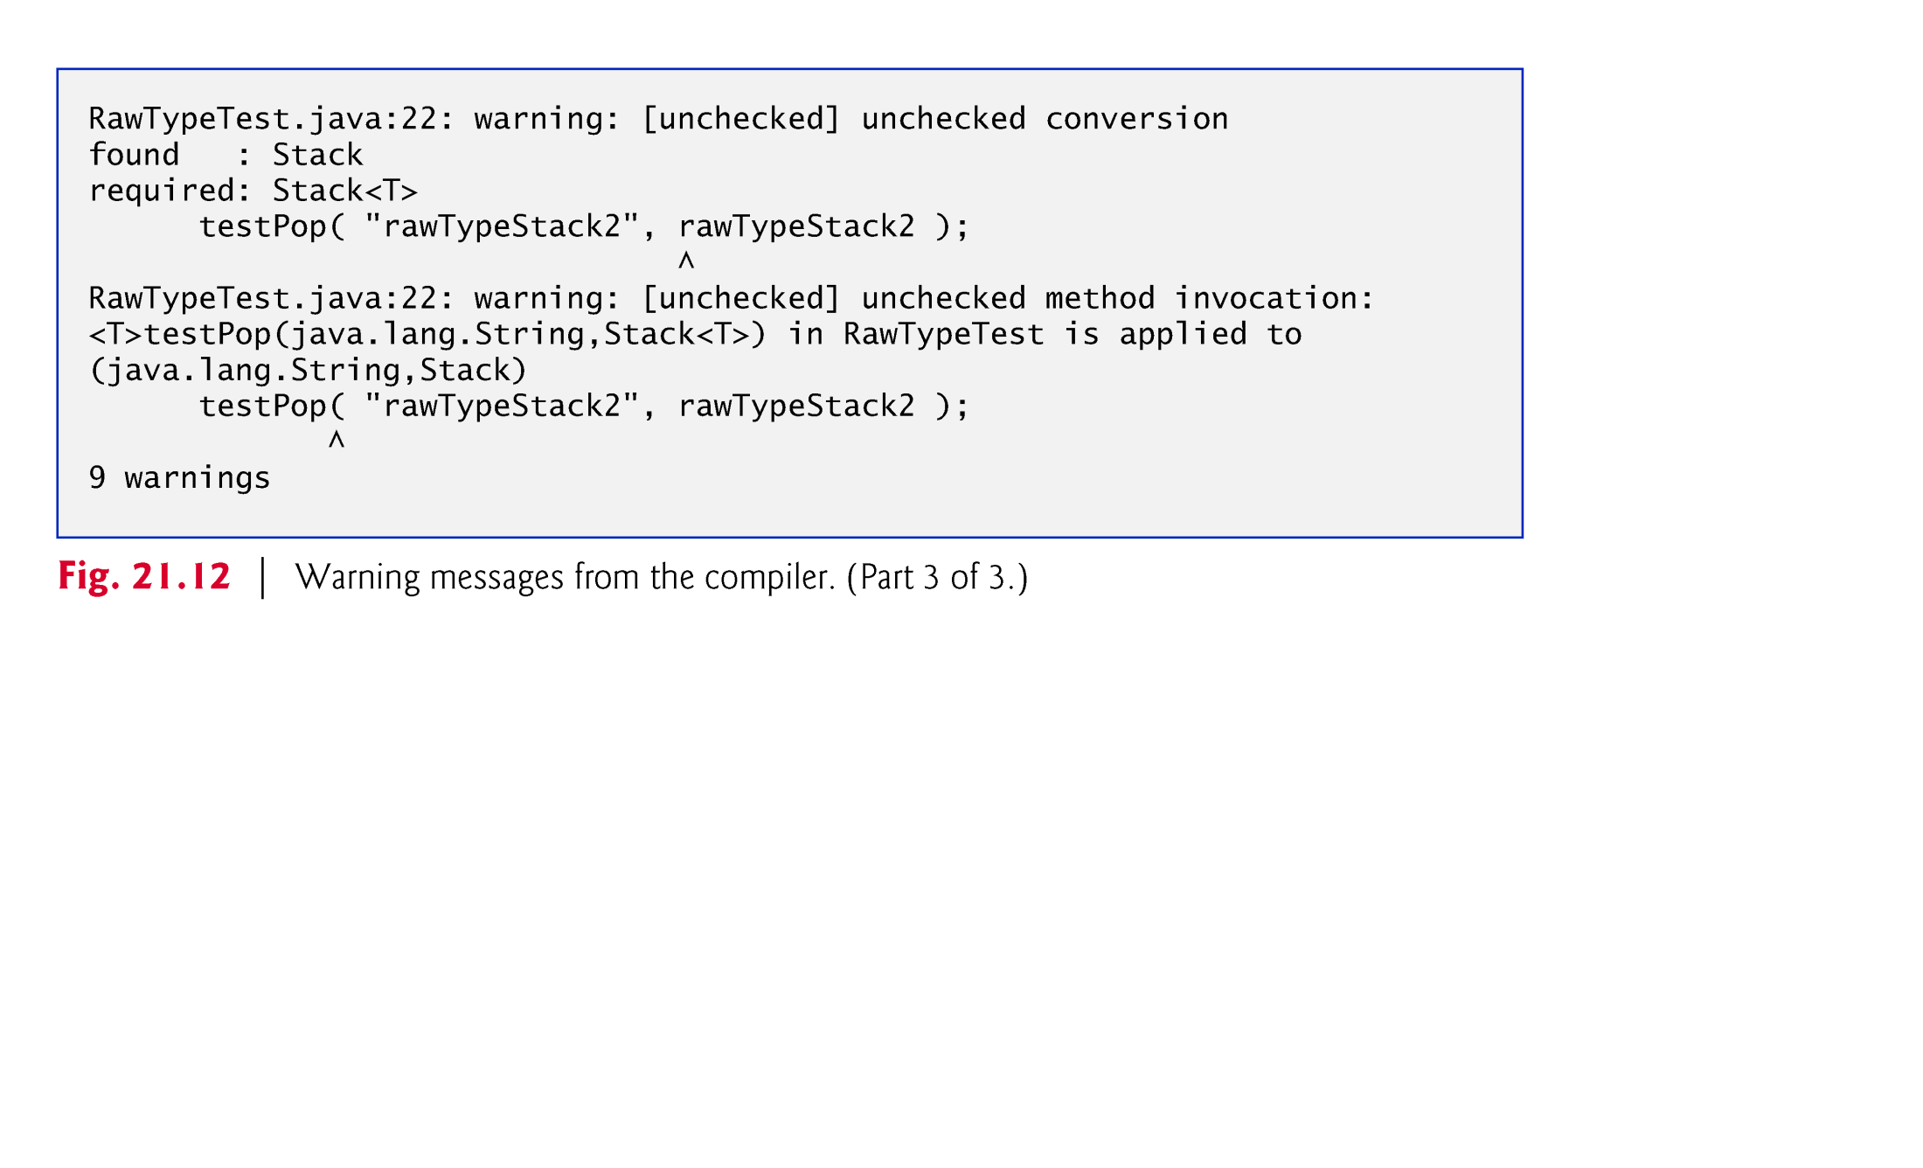

Slide 50
20.8 Wildcards in Methods That Accept Type Parameters
In this section, we introduce a powerful generics concept known as wildcards(通配符).
Suppose that you’d like to implement a generic method sum that totals the numbers in an ArrayList.
You’d begin by inserting the numbers in the collection.
The numbers would be autoboxed as objects of the type-wrapper classes—any int value would be autoboxed as an Integer object, and any double value would be autoboxed as a Double object.
We’d like to be able to total all the numbers in the ArrayList regardless of their type.
For this reason, we’ll declare the ArrayList with the type argument Number, which is the superclass of both Integer and Double.
In addition, method sum will receive a parameter of type ArrayList<Number> and total its elements.

Slide 51
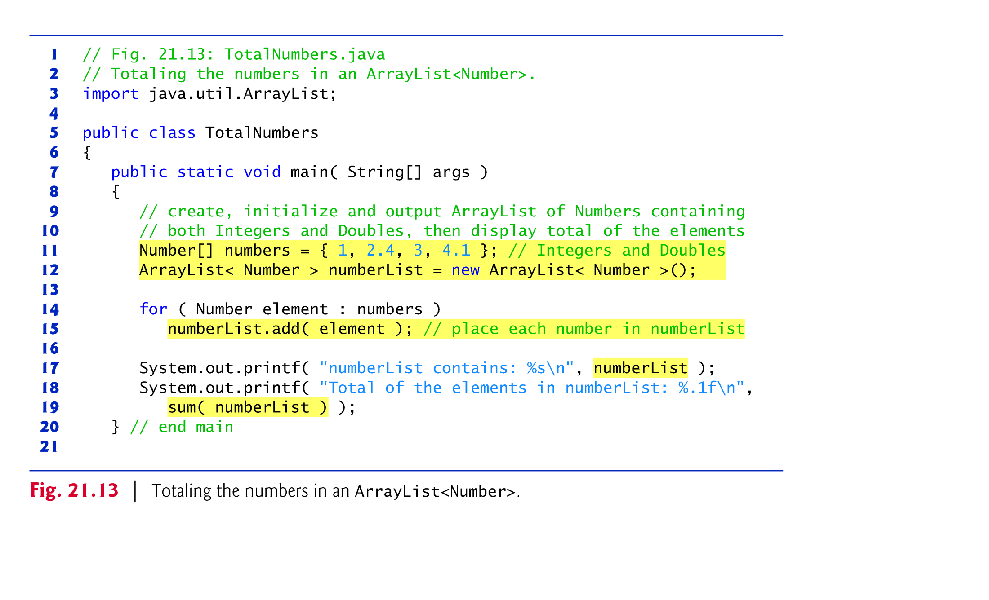

Slide 52
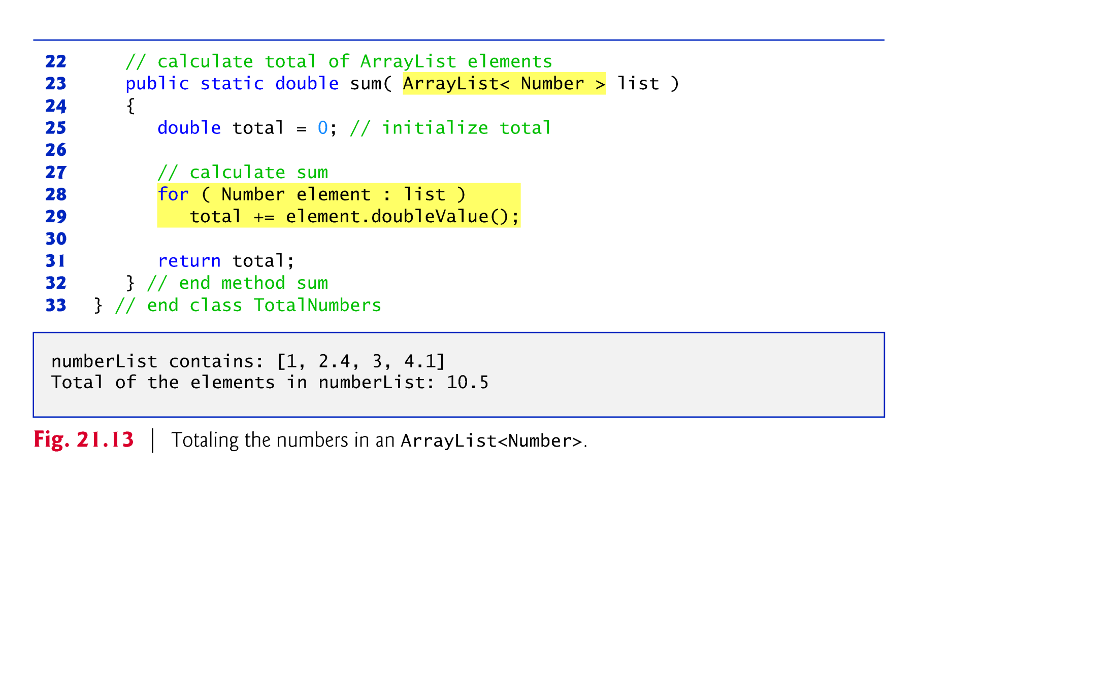

Slide 53
20.8 Wildcards in Methods That Accept Type Parameters (cont.)
In method sum:
The for statement assigns each Number in the ArrayList to variable element, then uses Number method doubleValue to obtain the Number’s underlying primitive value as a double value.
The result is added to total.
When the loop terminates, the method returns the total.

Slide 54
20.8 Wildcards in Methods That Accept Type Parameters (cont.)
When we compile the program, the compiler issues the following error message:
sum(java.util.ArrayList<java.lang.Number>) in TotalNumbersErrors cannot be applied to (java.util.ArrayList<java.lang.Integer>)
Although Number is the superclass of Integer, the compiler does not consider the parameterized type ArrayList<Number> to be a superclass of ArrayList<Integer>.

Slide 55
20.8 Wildcards in Methods That Accept Type Parameters (cont.)
To create a more flexible version of the sum method that can total the elements of any ArrayList containing elements of any subclass of Number we use wildcard-type arguments.
Wildcards enable you to specify method parameters, return values, variables or fields, and so on, that act as supertypes or subtypes of parameterized types.
ArrayList< ? extends Number >

Slide 56
20.8 Wildcards in Methods That Accept Type Parameters (cont.)
A wildcard-type argument is denoted by a question mark (?), which by itself represents an “unknown type.”
In this case, the wildcard extends class Number, which means that the wildcard has an upper bound of Number.
Thus, the unknown-type argument must be either Number or a subclass of Number.

Slide 57
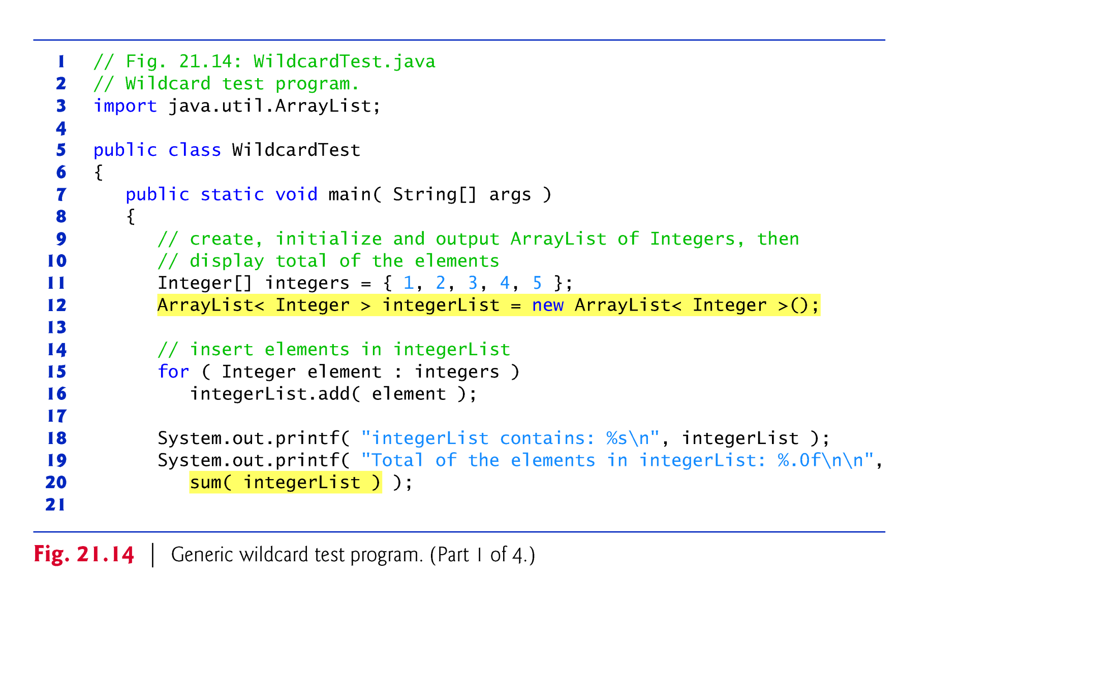

Slide 58
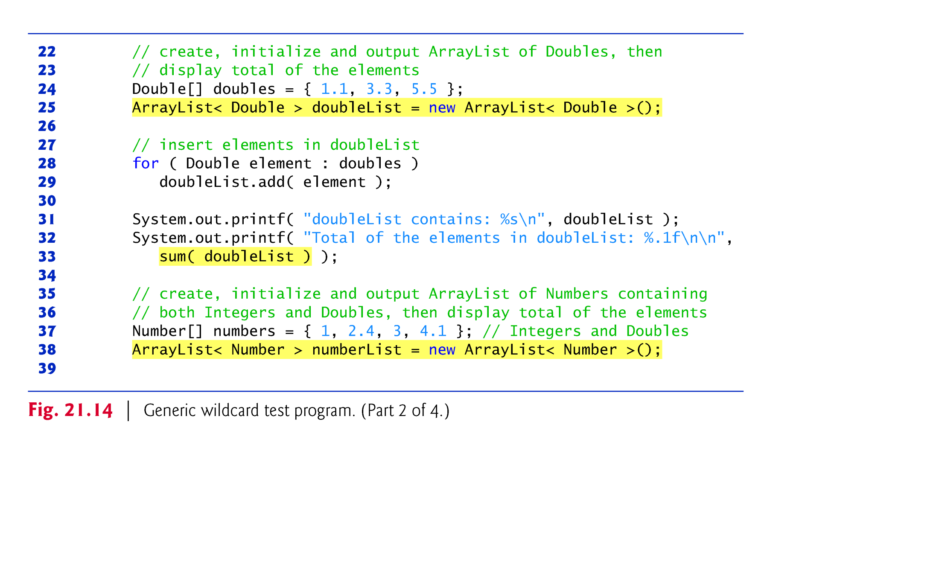

Slide 59
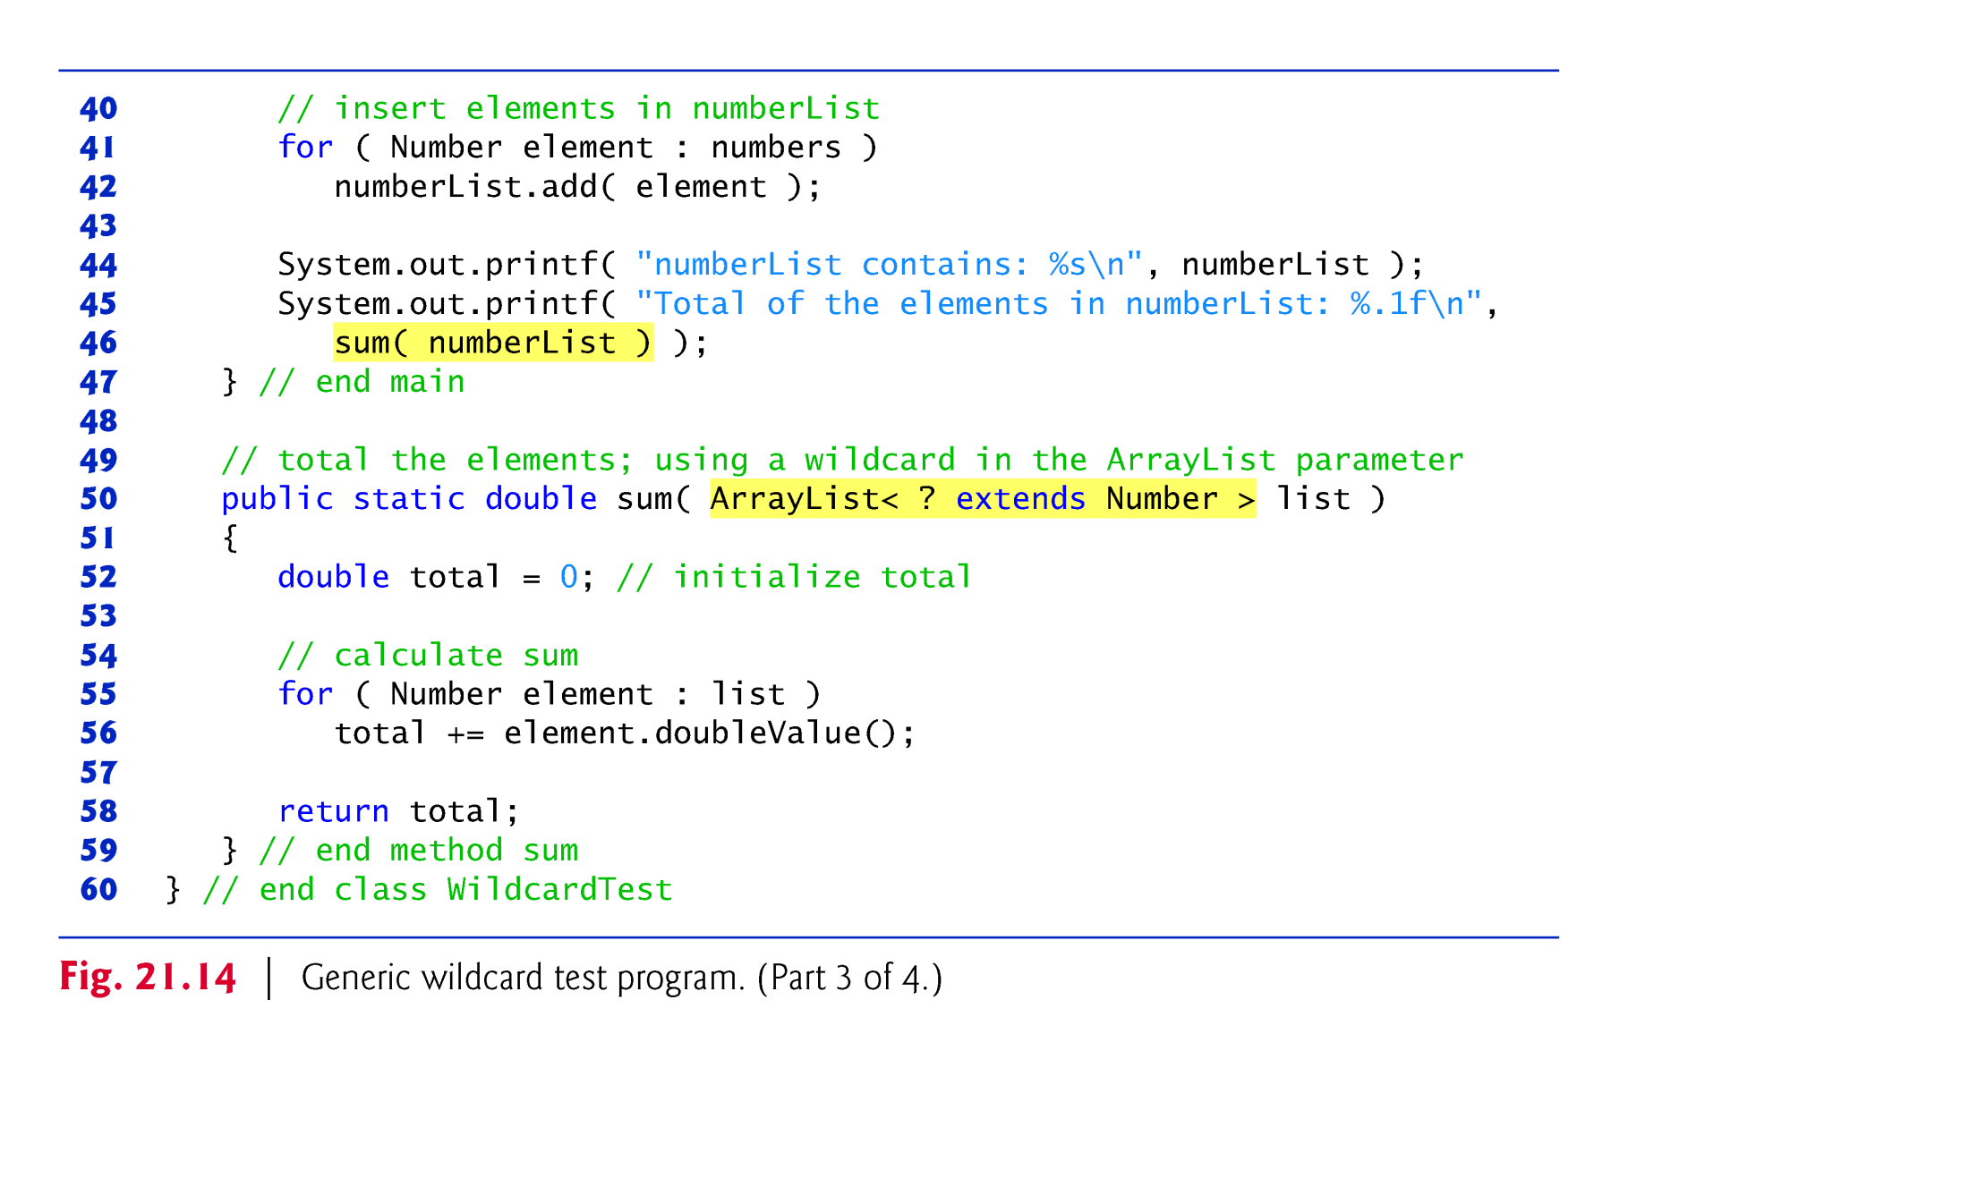

Slide 60
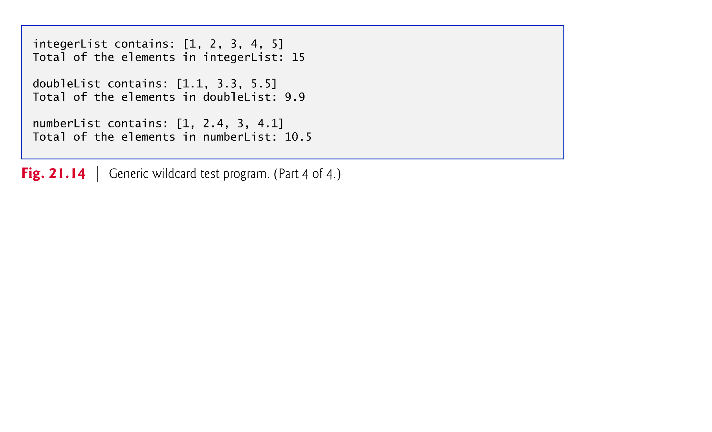

Slide 61
20.8 Wildcards in Methods That Accept Type Parameters (cont.)
Because the wildcard (?) in the method’s header does not specify a type-parameter name, you cannot use it as a type name throughout the method’s body (i.e., you cannot replace Number with ? in line 55).
You could, however, declare method sum as follows:
public static <T extends Number> double sum( ArrayList< T > list )
allows the method to receive an ArrayList that contains elements of any Number subclass.
You could then use the type parameter T throughout the method body.

Slide 62


